Slide 1
Seeing is Believing: Vision Screening and Beyond in Maryland Schools
Tresa M.S. Wiggins MSN, RN, CPNP-PC.
SR. NP at the Rales Health Center
JHU School of Medicine

Slide 2
Relevant Disclosures
I serve as a volunteer for the MASBHC Board of Directors. I receive no financial benefit from this volunteer work.
I have no financial disclosures to report

Slide 3
Objectives
Participants will be able to describe MSDE guidelines for vision screening in schools
2. Participants will be able to compare the roles of screening in school-based health centers vs school health services
3. Participants will be able to describe common eye disorders in pediatrics identified through screening
4. Participants will be able to discuss MSDE guidelines for follow up of referred students from screening
5. Participants will be able to identify some resources available to support students who need follow up services

Slide 4
Please Share Out
Knowledge sharing is a valuable part of learning --- please share your experiences of screening and follow up in schools and SBHCs
Notes:
While this presentation will go over many components of vision in schools and follow up in maryland, we know what happens on the ground has its own flair and implementation , and we can all learn form each other's work

Slide 5
Definitions
Screening : Detecting those who are at risk of having a condition is not diagnostic of a condition. Those who are positive, fail or are referred will need an examination to confirm the presence or absence of disease
Examination: A detailed exam performed by a qualified professional is what provides a diagnosis. This is often considered the next step for FOLLOW-UP if screening identified a concern
Notes:
Screenings --- In public health setting screneing are usually considered an opt out for consent as they are usually less invasive and do not carry a lot of risk and may be performed by layperson
Examination- Considered a Opt in ( signed consent needed)

Slide 6
Vision Screening in Schools

Slide 7
Through School Health Services

Slide 8
MSDE Vision Screening Guidelines…Who to Screen?
Who does screening include?
“County board or county health department to provide vision screenings for all students in the public schools…. Unless evidence is presented that a student has been tested by an optometrist or ophthalmologist within the past year, vision screenings required under MD. Code Ann., Educ. § 7-404 shall be given in the year that a student enters a school system, enters the first grade, and enters the eighth or ninth grade”
I.e. all students enrolled in schoo l- coordinated usually with front office or school health services (school nurse)
Who does not get screened?
Those who parents object in writing may opt out
Those who provide evidence of optometry or ophthalmology exam within the last year

Slide 9
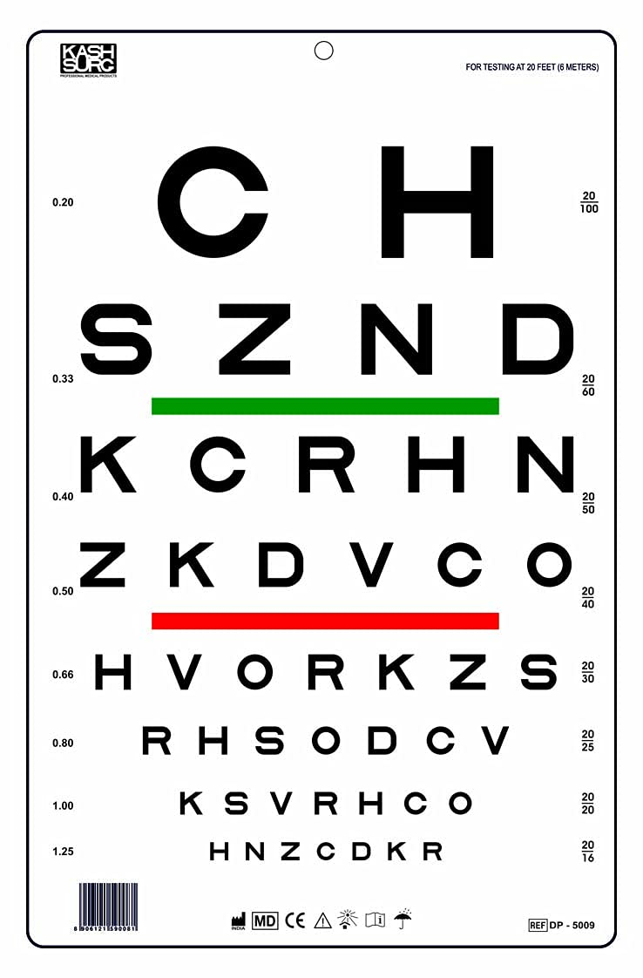
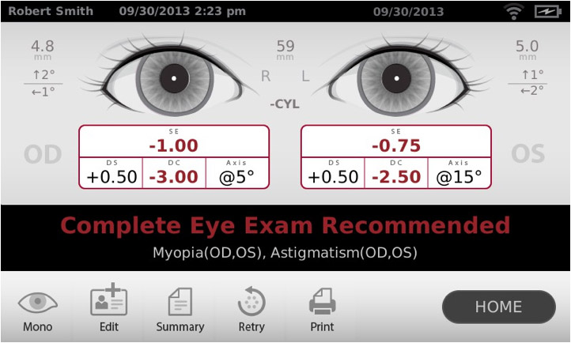
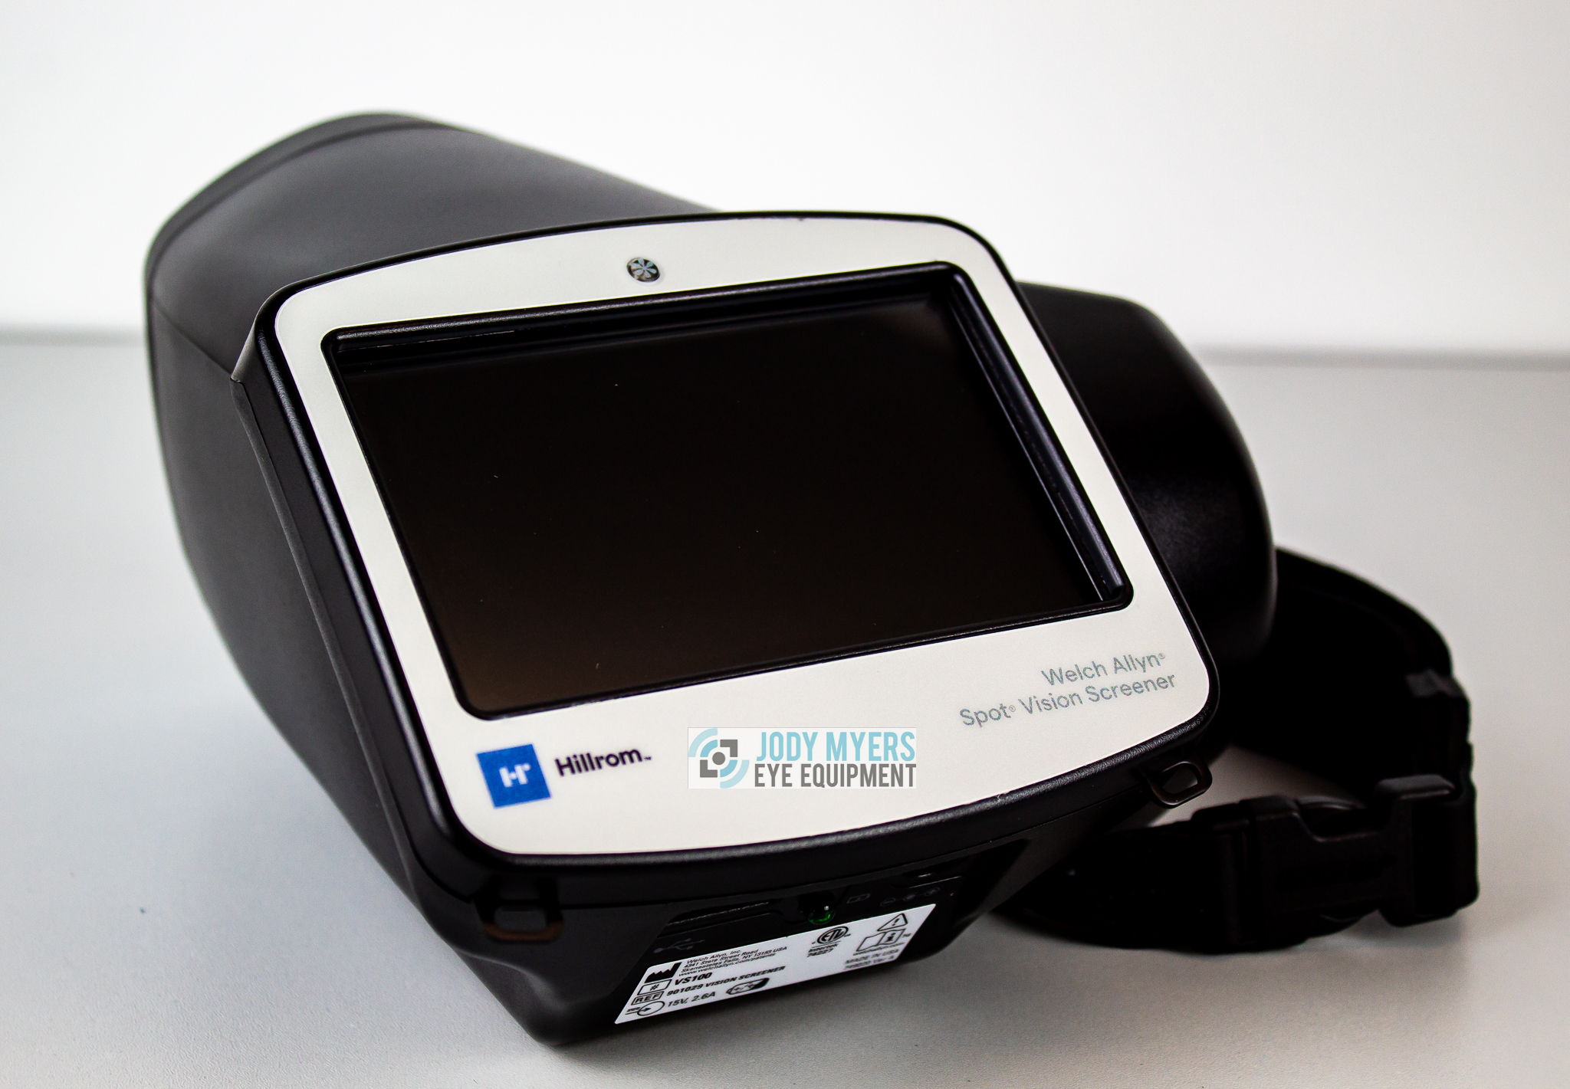
MSDE Vision Screening Guidelines…HOW?
Age3-5
Optotype-based Monocular Distance Visual Acuity ( lea/hotv)
Age 6 and up
SLOAN letters
As a supplemental option :
Instrument based screening

Slide 10
Vision Screening in School Based Health Centers

Slide 11
SBHCs and Vision Screening
Expanded vision screening is not discussed in sbhc guidelines
Recommendations in Maryland SBHC guidelines:
"Preventative services care is consistent with EPSDT guidelines"
EPSDT guidelines include:
Screening is indicated at every well check, including ophthalmascope, PERRLA, EOMS, monocular test, and external eye exam
In general, the following vision screens are conducted according to Maryland EPSDT standards:
Vision screening may also be indicated for other visits including : Headache, assessment for ADHD or behavioral evaluations, dizziness, neurologic concern, or eye injury
Screening Test | Age at Screening
Acuity | 4 through 20 years
Muscle Balance | 4 through 20 years
Visual Fusion | 4 through 6 years
Hyperopia | 7 through 20 years
Notes:
For screening there no other formal reference in previous guidleines, or guidleines that were available for public comment

Slide 12
School Health Services VS SBHC screenings
School health services | School based health centers
Population wide in designated grades guided by MSDE guidelines | As SBHC services are based on opting in (not universally available to the school), could be done for all enrolled students
Usually performed by district or in some instances school nurse | For relevant visits such as WCC, or health concern where vision may contribute
 | Usually performed by SBHC staff as part of visit process
Notes:
OF npte for SBHCs and stand alone vision screening..... According to the Medicaid SBHC billing manual, yes you can bill for a stand-alone vision screening. However, the fee schedule says that the reimbursable amount for that service is $2.60/screening. So it may not be worth the work/cost of actually submitting the bill to do it.
Who is perfomring vision screneing in your districts

Slide 13
Eye Problems Commonly Identified in Pediatric Vision Screenings

Slide 14
Refractive error
Farsightedness (hyperopia). Close objects are blurry to a child (such as when reading),--- "I can see Your (HypYOURropia) board but not my book"
Nearsightedness (myopia) A child sees near objects more clearly than distant objects---- " I can see MY(opia) Book but not your board"
Astigmatism – the front of the eye (cornea) is not symmetrically shaped as a result everything is blurry " I ca not focus to see your book or my board because it is ALL ( A- stigmatism) blurry
Notes:
As with all things- the degree to which the change varies from normal is the degree to which it will affect vision- not all require treatment – and with all things related to Kids growth and devleopment can rapidly affect how these progress so once identified annual exams are often recommenend

Slide 15
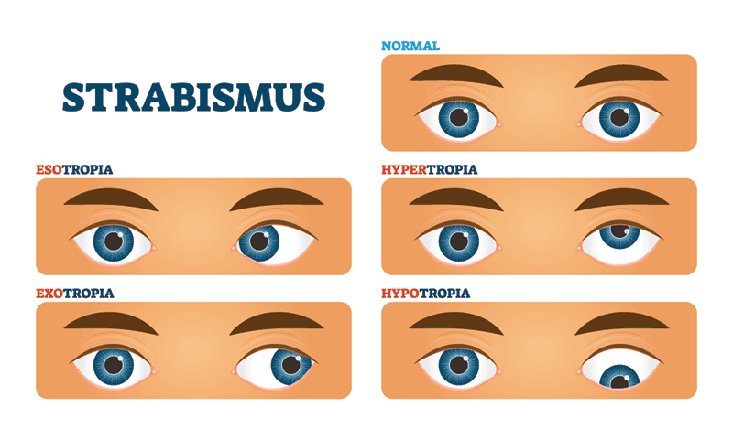
Strabismus
The eyes are misaligned either all the time or in certain fields of vision
i.e the muscles around the eyes do not move them at the same angle consistently
Eyes can be misaligned in any direction i.e inward, upward, downward
Treatment: Depends on severity- ranges from corrective glasses to eye patching or eye muscle surgery

Slide 16
Amblyopia
Sometimes called Lazy eye ( vision is poor)
The eye and the brain are not working well together- the brain prioritize the vision in the "well" working eye and the other eye becomes " lazier"
If untreated the " lazy " eye works less and less and is the most common cause of vision loss in kids
Identified well w/auto refractor
Can have unknown cause or can develop b/c one eye's vision is more affected by another condition such as nearsightedness than the other eye
Treatment: If treated early, results in good outcomes. If not treated until later ages, vision outcome is poorer
First treat underlying eye condition and retrain the brain with either eye patching or eye drops

Slide 17
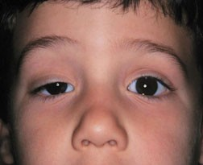
Ptosis
Aka Droopy eyelids – weakness in the muscle that controls the lid. It can be in one or both eyes
Not typically identified through acuity or autorefractor. It I more commonly noted w/external eye exam
If severe enough (considered when approximately greater than 50% of pupil obstructed), itcan cause vision loss and amblyopia
If severe, to be treat with eye surgery
Note**Child may also need exam by neurology to rule out other issues

Slide 18
Follow Up
What happens after a "fail" or "refer" occurs during screening?

Slide 19
School Health Service: MSDE Referral/Follow up Guidance – June 2023
DOCUMENTATION AND FOLLOW-UP The school nurse is responsible for:
• Communicating with the parent(s)/guardian(s) when a student has failed screening
• Providing parent(s)/guardian(s) of a student who has failed screening with a recommendation/referral to see an optometrist or ophthalmologist
• Assisting students and parent(s)/guardian(s) in selecting recommended services as needed
• Assisting a student and parent(s)/guardian(s) to identify a healthcare provider for students without a usual source of care
• Documenting screening results and receipt of services and interventions recommended by the optometrist, ophthalmologist, or other professional on the Student Record Card 5 (SR5)
• Informing appropriate school personnel of students who have vision concerns which may impede learning and/or require special care.
Notes:
While these are the recommended guidelines I am very curious to hear how this is going in your school and if you know who is doig it? This is a big lift for school nurses to take on esp given not all schools have a dedicated nurse

Slide 20
SBHCs Follow Up for Referral
Historically, eye exams ( optometry and opthamology ) are not currently included in expanded services list options for SBHCs in Maryland
Vision follow up is a service offered in other states in SBHCs w/ either dedicated full-service optometry offices or onsite clinics
Some examples include NYC and OH.... info below if you wish to read more about these
https://nyulangone.org/news/school-based-health-center-improves-vision-brooklyn-children
https://www.nationwidechildrens.org/specialties/school-health-services/vision-care

Slide 21
Referring Students Requiring Follow Up
Medicaid covers 1 eye exam a year and 2 pairs of glasses if dispensed at least 1 month apart
Finding a provider can be difficult as optometry also has a shortage
For most students, starting with Optometry visit is sufficient and often easier to get into than Ophthalmology
"Shopping center" eye clinics will often accept Medicaid and private eye insurance if available
Recommend calling to verify, prior to attending
Challenges:
If child needs Ophthalmology follow up, they will need to schedule another appt
Private insurance- there is usually some out of pocket cost, which is prohibitive for some families
Repeat exams w/Medicaid - not covered well
Students lose and break glasses like they are socks in a dryer
Notes:
Examples – My eye dr. charm city optical , vision works

Slide 22
Follow Up Options for Additional Support
Eye exams:
VSP program : paused
https://www.vspvision.com/eyes-of-hope/get-help.html#noCost
Target and Walmart 50 -100 for exam
Lions' Club application through LASH (Lions Club Association of MD)
https://www.lashmaryland.org/eyeglass- assistance-request/
Children's Eye Foundation
Uninsured/legal residents/ failed a screening
https://www.childrenseyefoundation.org/
Lost/ broken or cannot afford glasses:
Consider connecting with these companies:
141 Eye Wear (Eye wear (frames) company)
Changing life through lenses and frames
https://changinglifethroughlenses.org/
New Eyes - 10$ application fee
https://new-eyes.org/application
Note*** all these options require current prescriptions.
****141 and CLTL require addt'l program support
Notes:
141 and Changing life through lenses, usually would have a " champion" who would hel[p student pick out glasses from a selection known as "frame board" and then submit script and receive glasses

Slide 23
Monitor for Additional Options that Arise
The National Eye Institute
https://www.nei.nih.gov/learn-about-eye-health/healthy-vision/get-free-or-low-cost-eye-care

Slide 24
Program Examples
Notes:
Please excuse that my examples are both in Baltimore- My SBHC is in Baltimore and so it is what I Kow best , I would also love to hear about other supportive programs you all are utilizing and what those look like

Slide 25
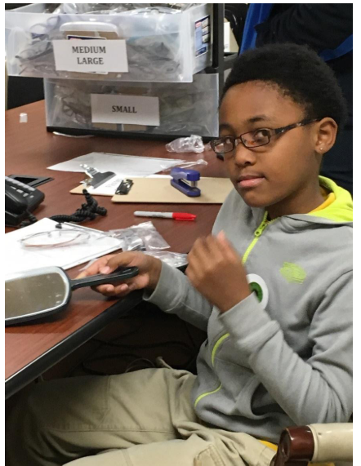
Program Example- Rales Health Center
Expanded vision screening
Referral to further eye exam
Community partnership
Glasses wearing and teacher assistance
Community partnership follow up / case management
Notes:
Please excuse that my examples are both in Baltimore- My SBHC is in Baltimore and so it is what I Kow best , I would also love to hear about other supportive programs you all are utilizing and what those look like
Expanded screneing is done through the SHS staff in partnership with local Nursing and medical students, E

Slide 26
Program Example – Vision For Baltimore
Expanded vision screening
Referral to further eye exam
Community partnership
Glasses wearing and teacher assistance
Community partnership follow up / case management
https://health.baltimorecity.gov/visionforbaltimore
https://visiontolearn.org/our-work/how-vision-to-learn-works/

Slide 27
Expanding your Vision Program – where to start
Considerations in Building a School-Based Vision Program
Ambrosino CM, Callan J, Wiggins TMS, Repka MX, Collins ME. Considerations in Building a School-Based Vision Program. J Sch Nurs. 2024 Oct;40(5):574-583. doi: 10.1177/10598405231163753. Epub 2023 Mar 28. PMID: 36974515.
School-Based Delivery of Vision Care in Chicago Public Schools
Storey N, Stafford-Hudson K, Harrow I, Tow B, Seo JY, Vidis JD, Collins M. School-Based Delivery of Vision Care in Chicago Public Schools. J Sch Health. 2023 Apr;93(4):324-330. doi: 10.1111/josh.13273. Epub 2022 Nov 19. PMID: 36401570.
Notes:
There is much emerging work around vision porgrams in the US w/ school here are a couple of examples of available information- Full disclosure- I assisted in writing the first article, I receive no financial compensation for doing so

Slide 28
Discussion
Notes:
I would love for people to share out where they are in their vision programming and their current biggest barriers and needs

Slide 29
References
VISION SCREENING GUIDELINES Maryland State School Health Services Guidelines June 2023
https://marylandpublicschools.org/about/Documents/DSFSS/SSSP/SHS/SHSGuidelines/VisionScreening_5.2023.pdf
Maryland EPSDT guidelines
https://health.maryland.gov/mmcp/epsdt/healthykids/pdf/SectionIII_pp13-20.pdf
Billing Maryland Medicaid: Guidance for SBHCs
https://health.maryland.gov/pophealth/Documents/Local%20Health%20Department%20Billing%20Manual/PDF%20Manual/Section%20IV/SBHC%20Introduction%20to%20Billing%20and%20Coding.pdf
MARYLAND MEDICAID SCHOOL-BASED HEALTH CENTER (SBHC) PROVIDER MANUAL
https://health.maryland.gov/mmcp/Documents/MD%20Medicaid%20SBHC%20Provider%20Billing%20Manual%20updated%208.2.24.pdf
National eye institute
https://www.nei.nih.gov/learn-about-eye-health/eye-conditions-and-diseases
Healthy children by The American academy of pediatrics
https://www.healthychildren.org/English/health-issues/conditions/eyes/Pages/Specific-Eye-Problems.aspx

Slide 30
Thank you
Tresa M.S. Wiggins
Tschuma1@JHU.EDU

