Slide 1
Trauma-Informed Essentials for School Health Professionals
Jerica Knox, PhD¹ & Mayra Gaona, PhD²
¹Assistant Professor, University of Maryland School of Medicine
¹Core Faculty, National Center for School Mental Health
²Clinical Research Coordinator, Urban Youth Trauma Center

Slide 3
What You Can Expect
1
2
3
4
Understand the essential principles of TIPs in schools
Identify practical strategies for implementing TIPs
Explore culturally responsive TIPs
Understand secondary traumatic stress
What We Can Expect
1
2
3
Think about content from your role
A curiosity or appreciation for cultural responsiveness
Participation!
☺

Slide 4
Let’s Discuss!
Why did you choose your profession?

Slide 5
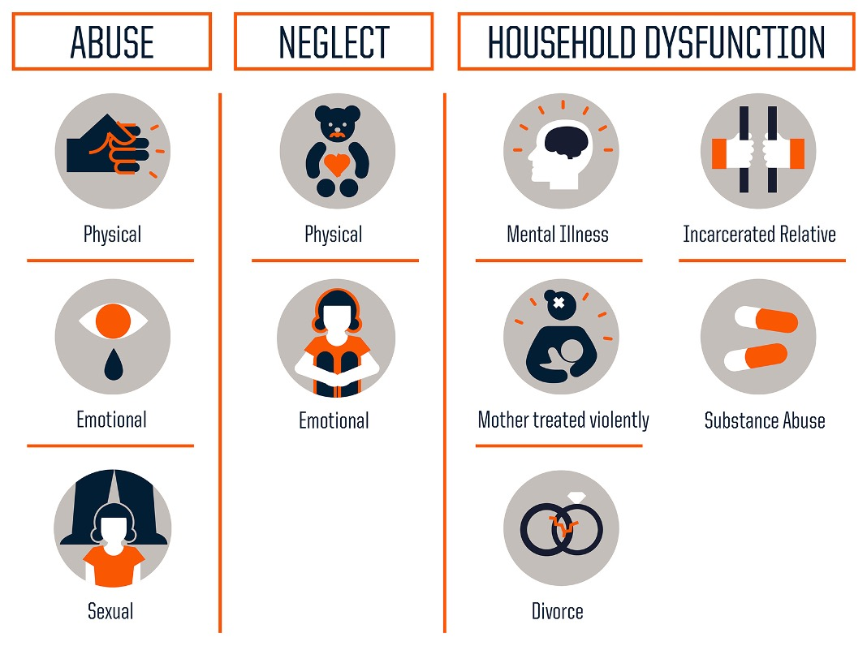
Adverse
Childhood
Experiences
Study
Felittli et al. (1998)

Slide 6
Impact on Child Development
Frequent tantrums
Delays in language development
Separation anxiety
Difficulty forming secure attachments
Behavioral regression (e.g., bedwetting)
Increased anxiety or depressive symptoms
Trouble focusing on retaining information
Difficulty trusting adults or forming friendships
Aggression or defiance
Withdrawal or hyperactivity
Alienation from peers
Engagement in risky behaviors like risky sexual behavior or alcohol or drug abuse
Impaired executive functioning
Middle & High School
Preschool
Elementary School

Slide 7
Schools are an ideal setting for helping children who have experienced trauma.

Slide 8
Realize
Realize the widespread prevalence and impact of trauma.
Recognize
Recognize signs of trauma and the need for learning supports.
Respond
Respond to trauma with developmentally appropriate support to enhance student success.
Resist
Resist retraumatization by integrating principles of trauma-informed care into practices and responding to student and staff needs for self-care.

Slide 9
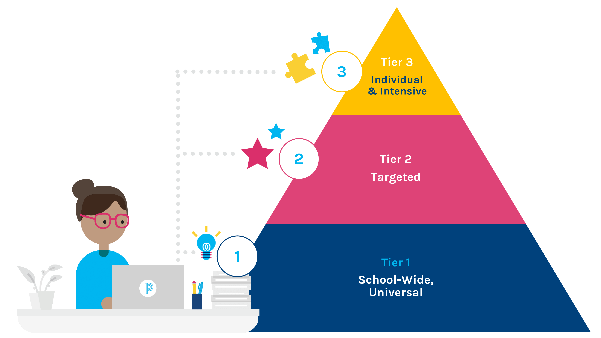
Trauma-Informed Practices Across Tiers
Multi-tiered Systems of Support (MTSS):​
A framework that supports us in 1) identifying students’ academic, behavioral, and social-emotional strengths and challenges 2) providing differentiated supports based on student needs
Note: While MTSS models + frameworks have been developed, the evidence base demonstrating their overall effectiveness is limited​
Separately, however, different TIP practices and their effectiveness have been examined --> positive effects
Branching Minds, n.d.; National Child Traumatic Stress Network, 2017

Slide 10
Trauma-Informed Practices Across Tiers
Tier 1 - Safe Environments and Universally Healthy Students/Creating and Supporting a Trauma-Informed School Community​
Schools transform on a number of levels to create and support safe environments that promote healthy and successful students and staff. This foundational work is Tier I of the MTSS pyramid and necessary to support strategies across the entire pyramid.​
Practice Examples:​
Universal screening​ utilizing behavior screeners like:​
→Trauma Symptom Checklist for Children (TSCC)​
→ Child Behavior Checklist (CBCL)​
→ Child and Adolescent Trauma Screen (CATS)
Trauma professional development for all school staff​
Social-emotional learning curriculum​
Classroom specific strategies that are supportive​
→ Example: Creating a "calm corner" in the classroom​
School-wide policies and practices that promote a positive and safe school culture​
→ Example: Revising discipline codes and promoting restorative justice practices​
​
National Child Traumatic Stress Network, 2017

Slide 11
Discussion Question: What Tier 1 support(s) are implemented in your setting? What is a Tier 1 support that you would like to incorporate?

Slide 12
Trauma-Informed Practices Across Tiers
Tier 2 – Early Intervention/Identifying Students and Staff At Risk
Schools identify and respond to students and staff who are at-risk or have been exposed to trauma and/or loss in ways that meet their unique exposures, experiences, developmental, and personal needs.
Practice Examples:
Risk and threat assessments
Check In/Check Out + mentoring programs
Peer supports for educators displaying signs of burnout
Brief or group trauma-focused interventions:
→ Cognitive Behavioral Therapy (CBT) with additional components such as mindfulness, stress inoculation, and creative/expressive elements
→ Bounce Back
→ Cognitive Behavioral Intervention for Trauma in Schools (CBITS)
National Child Traumatic Stress Network, 2017

Slide 13
Discussion Question: What Tier 2 support(s) are implemented in your setting? What is a Tier 2 support that you would like to incorporate?

Slide 14
Trauma-Informed Practices Across Tiers
Tier 3 - Intensive Support​
Schools provide support to those students whose behaviors and experiences necessitate intensive interventions and aim to meet their unique exposures, experiences, developmental, and personal needs.​
Practice Examples:​
Individualized education plan (IEP) or student support plan​
Crisis protocols that include restorative strategies and do not harm relationships​
Wraparound services ​
Health professionals’ collaboration with external providers and care planning
Intensive, individual one-on-one interventions for students with significant trauma histories​
→ Trauma-Focused Cognitive Behavioral Therapy (TF-CBT)​
→ Support for Students Exposed to Trauma (SSET)​​
National Child Traumatic Stress Network, 2017

Slide 15
Tier 3: Additional Trauma Interventions​
Child-Parent Psychotherapy (CPP)
Early childhood (0-6)
Non-school based
Parent-Child Interaction Therapy (PCIT)
Early childhood (2-7)
Non-school based
Trauma-Focused Coping in Schools (TFC)
6-18 years old
School-based
Child and Family Traumatic Stress Intervention (CFTSI)
7-18 years old
Non-school based
Brief, early intervention to be implemented within 30-45 days following a traumatic event or disclosure of physical or sexual abuse
Trauma Systems Therapy (TST)
6-19 years old
Non-school based
Model of care for traumatized children that addresses both the individual child’s emotional needs as well as the social environment in which they live

Slide 16
Discussion Question: What Tier 3 support(s) are implemented in your setting? What is a Tier 3 support that you would like to incorporate?

Slide 17
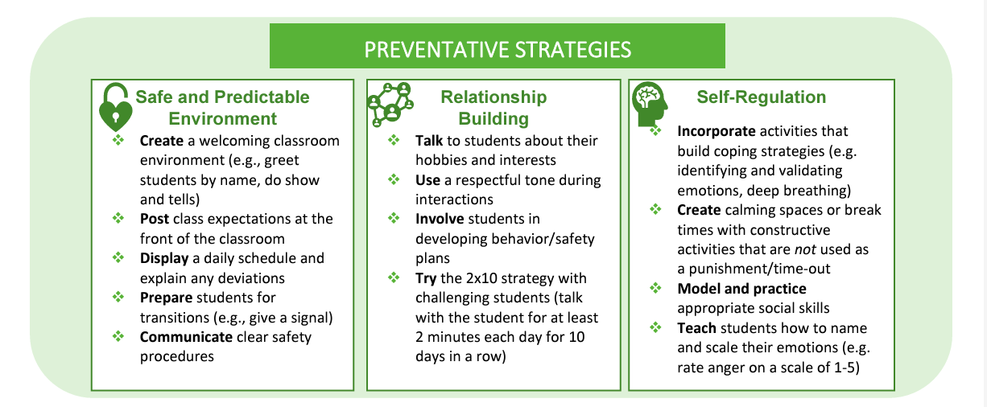
More Practices
Regional Educational Laboratory Appalachia, 2021

Slide 18
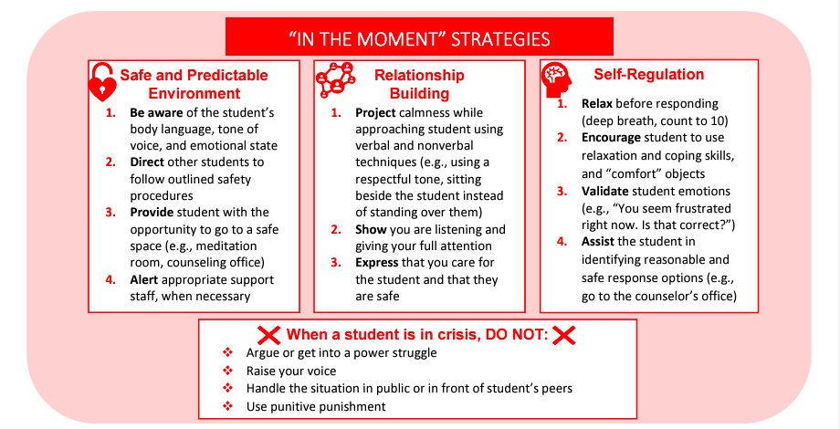
More Practices
Regional Educational Laboratory Appalachia, 2021

Slide 19
More Practices
Regional Educational Laboratory Appalachia, 2021

Slide 20
Additional Considerations
Beyond trauma-informed strategies:
Thinking about how we conceptualize trauma — what trauma experiences are we dismissing or leaving out of the conversation?
Shifting from blaming of families for their trauma experiences to considering what larger issues/conditions/systems led to these experiences?
Conversations on trauma need to incorporate culture, race, and equity

Slide 21
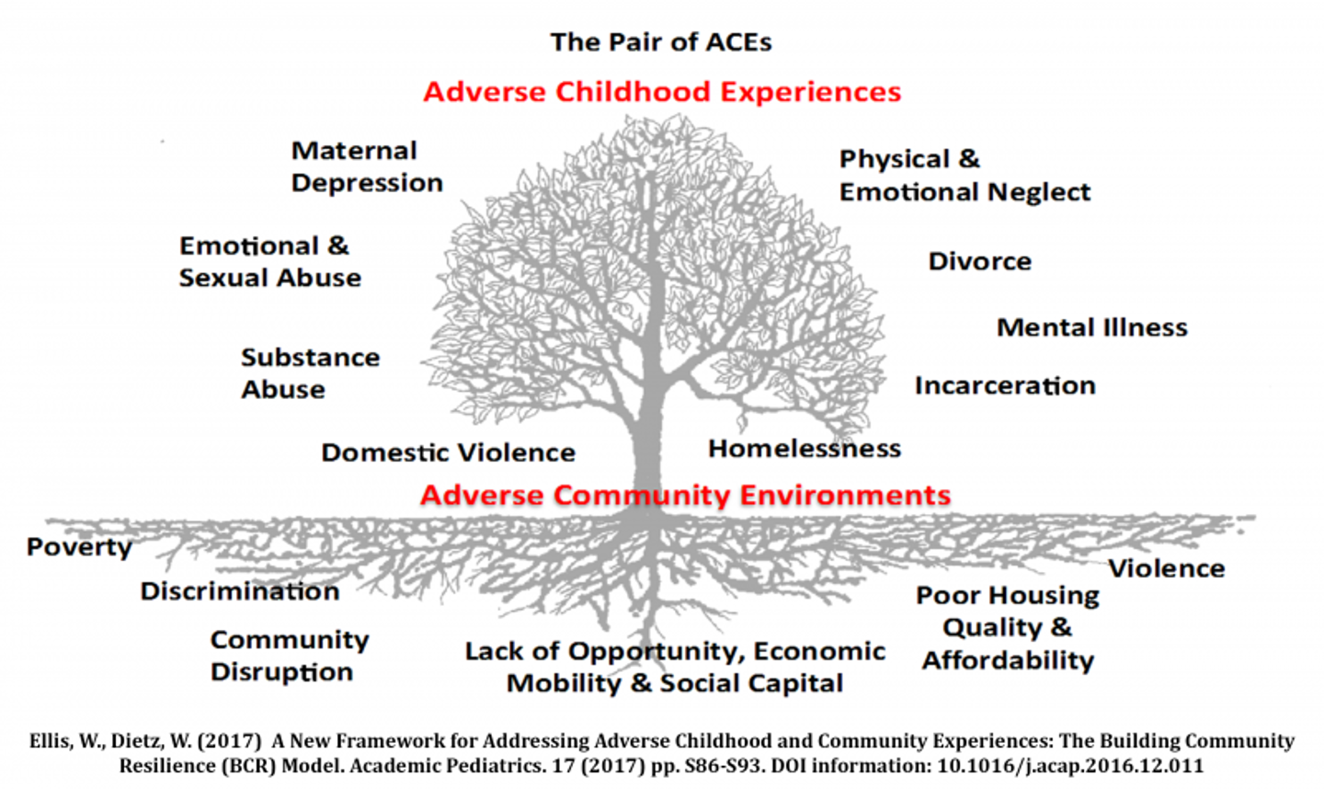

Slide 23
Are your trauma-informed practices culturally responsive?

Slide 24
Are your trauma-informed practices culturally responsive?
They affirm cultural identities.
They address systemic barriers.
They celebrate resilience.

Slide 25
Cultural Humility: A Foundational Approach
How were you expected to interact with authority figures? Was the authority of teachers and others assumed or did it have to be earned?
Were you taught to accomplish goals by yourself or as a team?
What did your parents and community tell you respect looks like? What about disrespect?
What social attributes were praised in your community? Which ones were you taught to avoid?
How were you taught to respond to different emotional displays—crying, anger, etc?
What family stories are regularly told or referenced? What messages do they communicate about core values?

Slide 26
Engage Families & Communities as Partners
Establish Safe and Inclusive Spaces
Address Systemic Barriers to Care
Center Students’ Cultural Strengths in Care

Slide 27
Quiz Time!
True/False: Trauma-informed practices only focus on supporting students who have experienced significant trauma.
True/False: School health professionals must know a student’s ACE score (or the traumatic events that have happened to them) to successfully intervene.
True/False: Culturally responsive trauma-informed practices require an understanding of how cultural backgrounds shape students’ responses to trauma.
True/False: I’m a teacher, not a school health professional—I can’t contribute to trauma-informed practice in schools!

Slide 28
A word on secondary traumatic stress…

Slide 29
A word on secondary traumatic stress…
Secondary Traumatic Stress: The experience of trauma-like symptoms (e.g., intrusive thoughts, emotion dysregulation) following exposure to traumatized individuals.

Slide 30
A word on secondary traumatic stress…
“Personal experiences have impacted my understanding of family trauma because I know how damaging experiences can be, and the long-term effects they have on people. Especially when it happens at such a formative age of being in middle school - they affect the way that you grow up and how you function as an adult. I went through trauma in middle school, and it has taken years to reverse the effects of it, many years later.” - Middle School Teacher

Slide 31
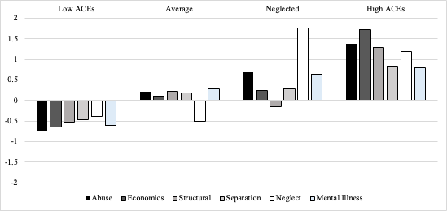
A word on secondary traumatic stress…

Slide 32
A word on secondary traumatic stress…
School personnel in the neglected and high ACEs profiles demonstrated higher levels of STS than those in the low ACEs and average profiles.

Slide 33
A word on secondary traumatic stress…
Promote self-care
But also… cultivate a trauma-informed workplace
Utilize counseling or supervision to process personal reactions to students’ trauma
Build a support network
Prioritize professional development

Slide 34
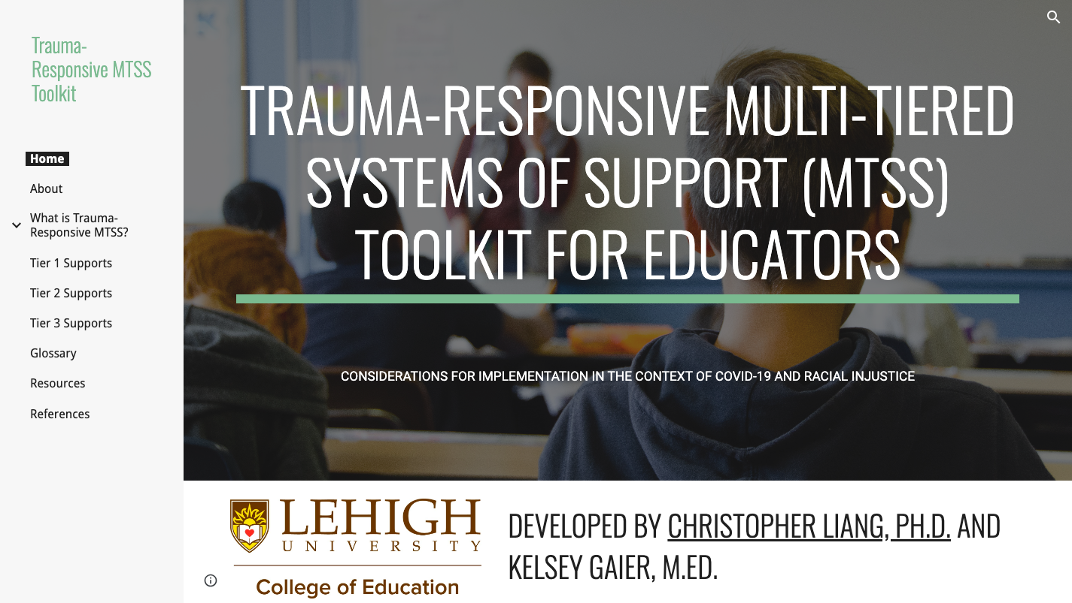
Resources
Creating, Supporting, and Sustaining Trauma-Informed Schools: A System Framework
Trauma-Responsive Multi-Tiered Systems of Support (MTSS) Toolkit for Educators

Slide 35
Resources
Proqol.org
Theshapesystem.com

Slide 36
That was a lot… Sum it up for me!
Trauma can impact children’s learning and behavior, and schools are an important place to address trauma.
Schools can implement trauma-informed practices within a multi-tiered systems of support framework.
Not every student will experience trauma, but a trauma-informed school benefits all.
Trauma is multidimensional and culturally contextual. Integrating cultural responsiveness into trauma-informed practices ensures care is equitable, relevant, affirming, and addresses the unique needs of students.
Pay attention to secondary traumatic stress! Self-care and supportive work environments are non-negotiables for school health professionals.

Slide 37
THANKS!
Mayra Gaona
gaonam@uic.edu
Jerica Knox
Jerica.knox@som.umaryland.edu

