Slide 1
Building to Success : SBHC Billing Practices
Presented by:
Amber Grabowski
Program Manager

Slide 2
Simple steps to success!
First Steps
Next
Enroll with MCOs and commercial insurance companies
Ensure access to payer portals for ease of access to staff
Training!!
Starting the process/procedures to billing
Continue with working on how to collect payments in a timely manner, ie; co-payments at time of visit, some payments due with a sliding fee scale.
Offer number of ways to collect payments
Prepare to make mistakes but have room for improvement always!

Slide 3
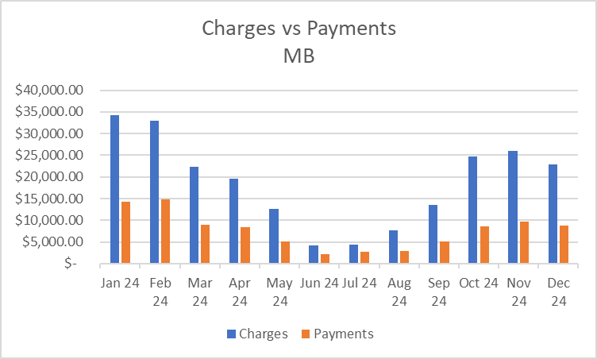
Sample: Charges/Payments by Month
MB SBHC

Slide 4
Lessons Learned
Inventory your current contracts/agreements
Ensure organization access to NPPES/PECOS for NPI creation
Understand what foundation you’re starting with and what you need to build
Plan for the process to take longer than you think
Include your team in as many training opportunities as possible
Insurance training, documentation for billing, accessing payer portals/EVS
Consider how to collect payments at the time of service; online payments, process for managing in person payments
Continuous process improvement and SEEK help when needed!

Slide 5
CONNECT WITH US!
Amber Grabowski
Program Manager
amber.grabowski@maryland.gov
EXPLORE MORE AT SMCHD.ORG
SMCHealthDepartment
SMCHD_gov

