Slide 1
Post-COVID Return to Play
Lou Kovacs, MD, CAQSM
Ankit Shah, MD, MPH, FACC
Kellie Loehr, MS, ATC, LAT

Slide 2
Primary Care Considerations
Cardiac Considerations
Return to Play Considerations
Q&A

Slide 3
Primary Care Considerations

Slide 4
Return to Sports in a Pandemic:
General Concepts
Reduce risk of transmission as low as possible
  Low community disease activity
  Masking, hygiene, cleaning, distancing
  Limit high-density public environments
  “Bubbling”
  Testing, testing, testing (unvaccinated)
Plan for and contain positives
  Symptom tracking
  Contact tracing
  Limit training group or cohort size
  Isolation/quarantine planning (housing, monitoring, testing, etc.)
  Scheduling flexibility (limit travel, plan for cancellation/postponement, etc.)
Identify individuals at elevated risk of complications upon RTP (e.g., myo/pericarditis)

Slide 5
Unlike last year, we now have vaccines!
Pfizer, Moderna, Johnson & Johnson
  Pfizer fully FDA approved as of 8/23/21 for 16y and older
  EUA 12y and above
  Pfizer EUA 5-11y as of 10/29/21 (CDC 11/2/21)
Really good for:
  preventing serious illness, hospitalization, death
  Avoiding need for “hard quarantine”
Not as good (but still pretty good) at:
  preventing infection (1/3 – ¼ risk?)
Not good at
  Reducing transmission to susceptible individual

Slide 6
Athletes Who Test Positive
  Isolation per CDC guidelines
  Contact tracing
  Convalescence
  Risk stratify for cardiac testing
  Gradual & monitored exercise progression

Slide 8
AAP Interim Guidance 9/21/21
Different criteria for severity compared to college-age
  Allows for increased duration of fever and flu-like symptoms
  May mean less need for cardiac testing and referral

Slide 9
AAP Symptom Severity

Slide 10
AHA 14-Element Screen

Slide 11
Mild or Asymptomatic
Usually can be handled by PCP
Usually uneventful RTP

Slide 12
Moderate
Usually at least ECG
Consider more gradual/monitored RTP

Slide 13
Triggers for Cardiology Referral
Severe disease
  Hospitalized, ICU/vent, MIS-C usually have inpatient Cardiology eval, need follow-up
Need for more thorough cardiac testing (stress, CMR, monitor, ?echo)
  Abnormal AHA screen
  Abnormal ECG
  Abnormal labs (e.g., elevated troponin)
  Recurrent/prolonged chest symptoms despite initial normal exam

Slide 14
Cardiac Considerations

Slide 15
Proposed Mechanisms of Cardiac Injury with COVID-19
Giustino, G. et al. J Am Coll Cardiol. 2020;76(17):2011–23.
Notes:
Acute lung injury, ARDS but also impact cardiac directly and indirectly.
Myocyte invasion- few reports confirming presence of viral inclusion bodies or sars cov2 RNA from myocardial tissue
Infmallation related injury: loss of ace2 recetor density and down regulation of ace2 leads to accumulation of angiotensin II which has vasoconstrictor, profibrotic and proinflammatory effects
Endothelial activation and thrombosis: ace2 is expressed in the circulatory system. Viral replications increases incites innate immune responses, interferon, IL6
Dysfunctional endothelium become proadhesive and prothrombotic

Slide 16
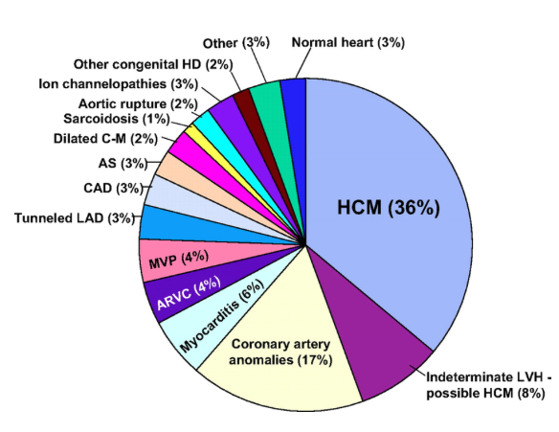
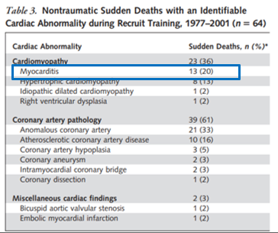
Causes of Sudden Cardiac Arrest/ Death in Athletes
SCD in 1435 young athletes (<35yo) from 1980-2005
Maron et al. Circulation 2007
Eckart et al. Ann Int Medicine 2004
- SCA/D cases in MS, HS, college and professional US athletes 2014-2016
- 179 cases (74 arrests with survival, 105 deaths)
- Myocarditis 4.3%
Danielle P. et al CJSM 4/2018

Slide 17
Exercise in Acute Myocarditis
Murine model of coxsackievirus B3 myocarditis
30 mice per group
60 minutes of swimming for 9 days
Increase viral titers, increased myocardial fibrosis and mortality in infected mice that exercised

Slide 18
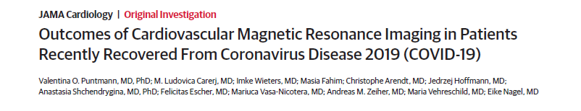
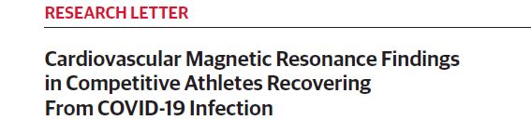
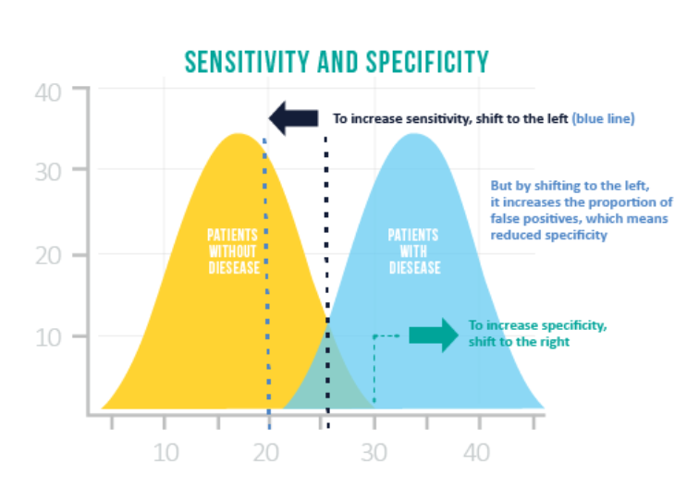
Early Concerns

Slide 19
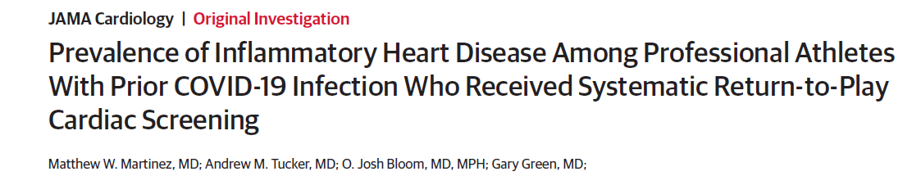
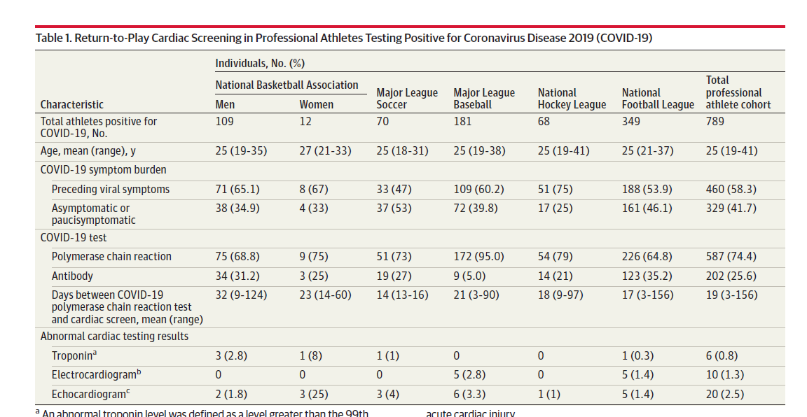
Professional Athletes
No severe illnesses or hospitalizations
30 (3.8%) athletes sent for additional testing
    cMRI in 27
      3 had myocarditis on MRI (0.4% of total cohort)
      2 had pericarditis (0.3% of total cohort)
No cardiac events
The 5 athletes with inflammatory heart disease:
  Had at least moderate symptoms

Slide 20
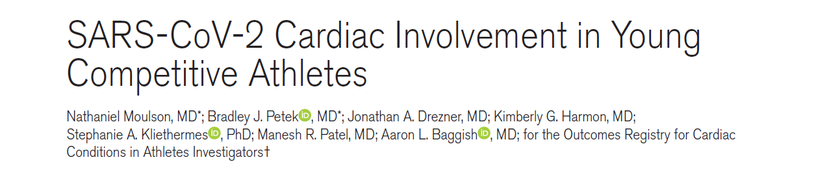
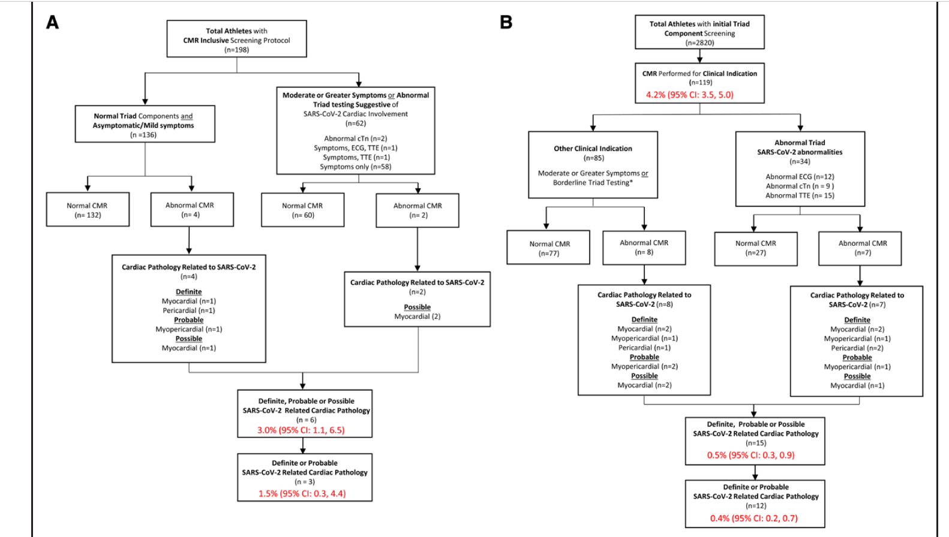
Circulation 2021; 144: 256-266.

Slide 21
Emergency Action Plan
SCA/SCD is inevitable regardless of screening method used…
We should be prepared
Greatest determinant of survival after SCA
  time from collapse to defibrillation
  survival rates decrease 7-10% per minute with every minute of delay

Slide 22
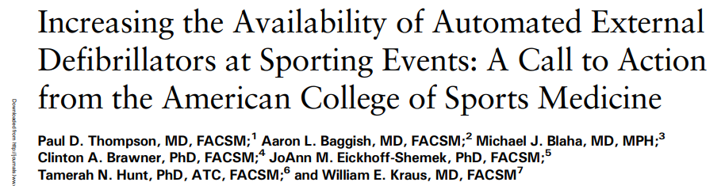
Sudden Cardiac Arrest (SCA)
1 of 70 high schools has a SCA even on campus yearly
50% in students or student athletes
  The other 50%: staff, spectators, coaches
66% occur at athletic facilities
Chance of survival increased by 50% if CPR is provided and defibrillation occurs within 3-5 minutes of arrest.
Current Sports Medicine Reports 2021 Vol 20 #8

Slide 23

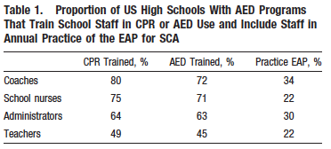
Cross sectional survey
1,710 high schools with onsite AED
July 2006 to July 2007
Drezner et al. Circulation 2009

Slide 24
AED Use for SCA in HS
36 cases (22 adults, 14 student-athletes)
35/36 (97%) witnessed arrests
Brief seizure like activity reported in 7/14 (50%) student- athlete after collapse
34/36 (96%) received bystander CPR
AED deployed shock in 30/36 (83%) of cases
Drezner et al. Circulation 2009

Slide 25
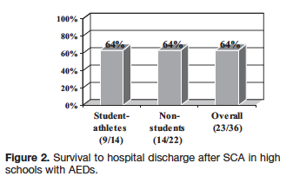
Survival rates to hospital discharge from out-of-hospital SCA in US cities using conventional emergency response systems are 5%
Drezner et al. Circulation 2009

Slide 26
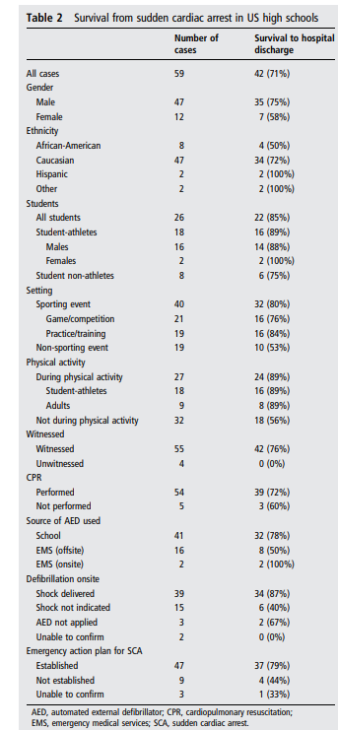
SCA Outcomes in US High Schools
2-year prospective observational study
2,149 high schools
Primary outcome
  Survival to hospital discharge
87% schools had AED program
59 cases of SCA, 26 (44%) students, 79% male
Drezner et al. Br J Sports Med 2013

Slide 27
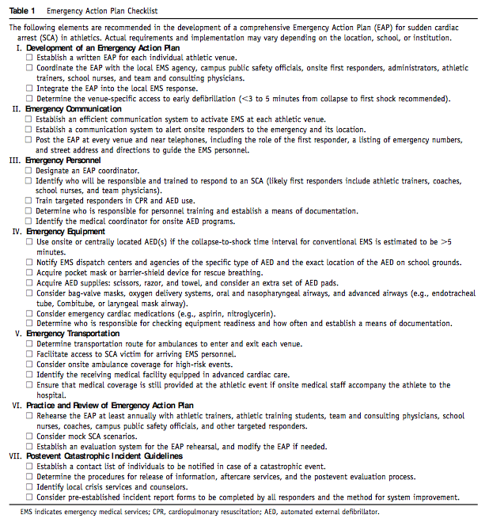
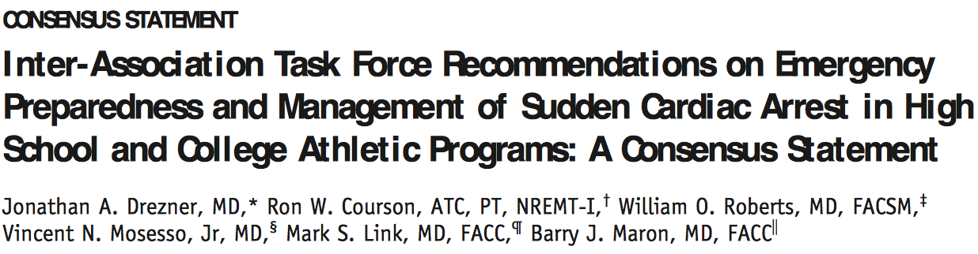

Slide 28
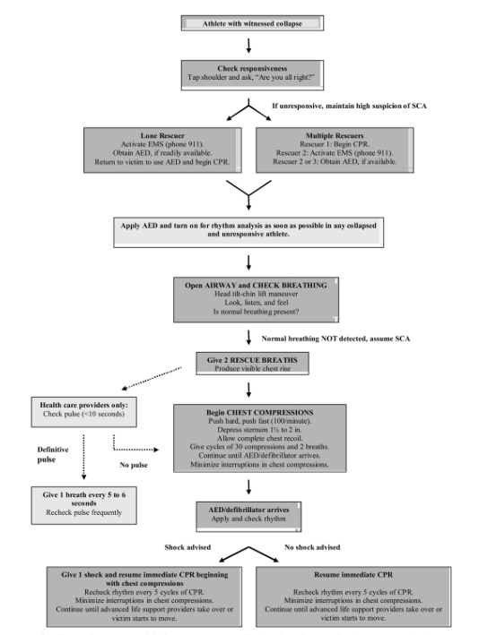
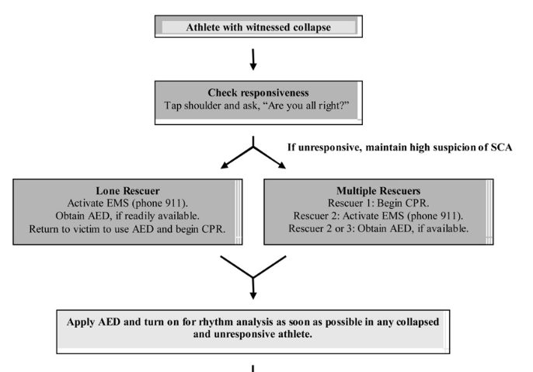
Pulse checks may be unreliable in critical situations even in experienced hands
Agonal breathing and seizure like activity may lead to misdiagnosis
Goal: AVOID delay in treatment

Slide 29
Vaccine Myocarditis
CDC:
  As of 8/25/21: 1,377 reports of myocarditis or pericarditis <30 y/o
  Most young males
  After mRNA vaccines
  798 of the reports were confirmed

Slide 30
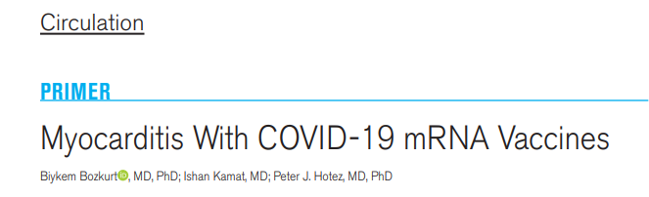
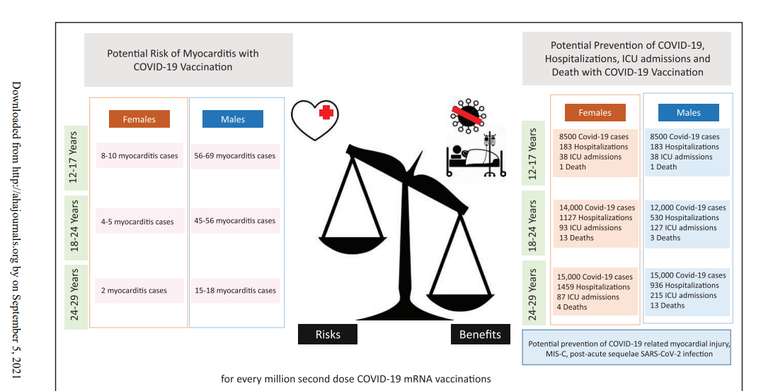
Circulation 2021 144 471-484

Slide 31
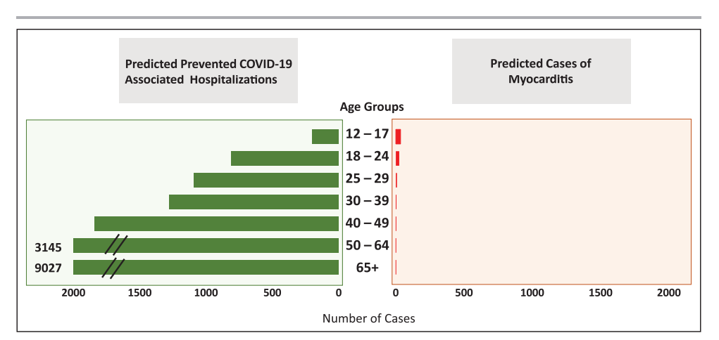

Slide 32
Graduated Return to Play

Slide 33
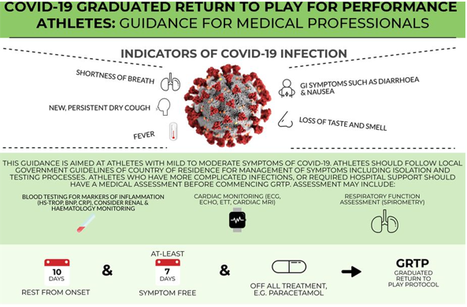
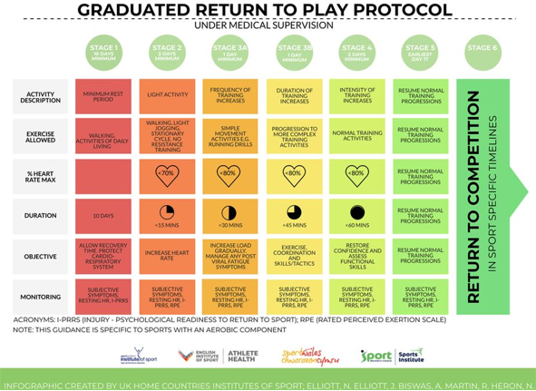
BJSM Graduated RTP Protocol
British Journal of Sports Med

Slide 34
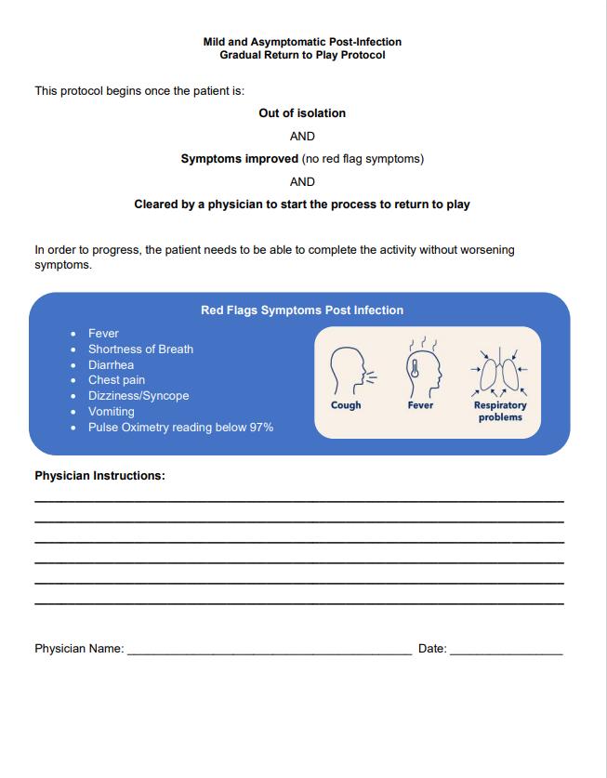
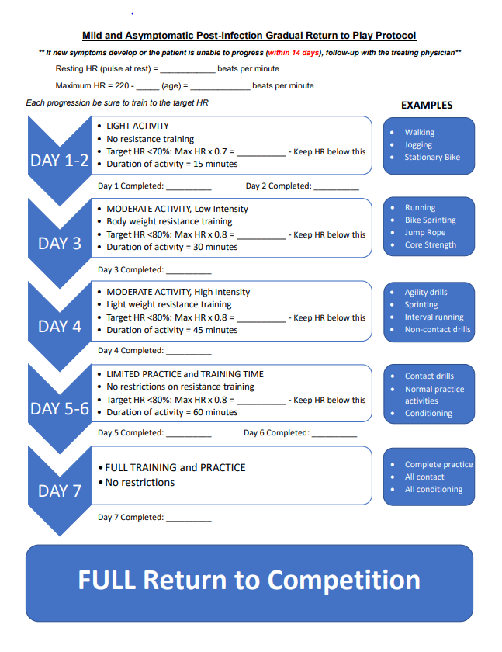

Slide 35
Other Considerations
What other activities is the patient doing inside the school?
  Choir, band, dance, performing arts, P.E. class
What activities is the patient doing outside of school?
  Other sporting activities, extracurriculars as above
How will these activities affect sport RTP and who is monitoring these?

Slide 36
Team Approach
Communication is Key!
  Care team may = PCP, ATC, strength coach, nurse, coaches, teachers
  Have frequent discussions with patient to see how they are progressing, as well as others who interact with them
Set expectations early & often for both S-A & care team
  Understand that setbacks may happen & some steps may take longer than others
  Each S-A should be treated on case-by-case basis
  Refer to PCP if not progressing appropriately or symptoms worsen
Review and practice your Emergency Action Plan

Slide 37
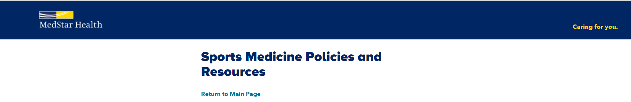
Resources
https://www.covid19.medstarapps.org/2020/07/09/sports-medicine-policies-and-resources-2/

