Slide 1
Introduction to Sickle Cell Disease
Dana Furstenau, MD, MS
Assistant Professor of Pediatric Hematology

Slide 2
Disclosures
I have no relevant financial or nonfinancial relationships to disclose

Slide 3
Objectives
Describe the basic pathophysiology of sickle cell disease and its different forms
Identify the common complications associated with sickle cell disease
Recognize the early signs and symptoms of a vaso-occlusive crisis (pain crisis) and other emergencies
Recognize when to implement immediate first-aid and emergency response protocols for a student experiencing complications from sickle cell disease
Outline essential day-to-day management strategies for students with sickle cell disease, such as ensuring adequate hydration, monitoring for signs of illness, and temperature regulation
List common medications for sickle cell disease and their purpose

Slide 4
Outline
Definition of Sickle Cell Disease
Background
  Red Blood Cells
  Hemoglobin
Cause of Sickle Cell Disease
Inheritance of Sickle Cell Disease
Complications of Sickle Cell Disease
Epidemiology
Management of Sickle Cell Disease
  Preventative Measures
  Medications
  Transfusions
Curative Options
  Hematopoietic Stem Cell Transplant
  Gene Therapy
Crisis Management
  Fever
  Pain
  Acute Chest Syndrome
  Stroke
  Priapism

Slide 5
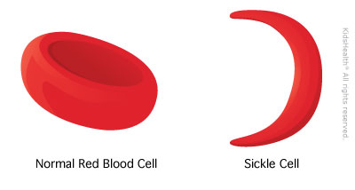
What is Sickle Cell Disease?
A group of inherited diseases that causes red blood cells to misshapen into a “sickle” shape
One of the most common monogenic disorders worldwide
Affects about 100,000 people in the US
https://kidshealth.org/en/teens/sickle-cell-anemia.html

Slide 6
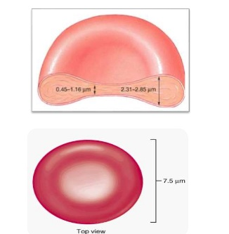
Background: Red Blood Cells
Responsible for delivering oxygen throughout the body
Biconcave in shape
Shape allows a large surface area to volume ratio, which is best for gas exchange
Shape allows the RBCs to form stacks to help flow through small capillaries
Flexibility of the cell also helps transport through capillaries
https://open.oregonstate.education/aandp/chapter/18-3-erythrocytes/

Slide 7
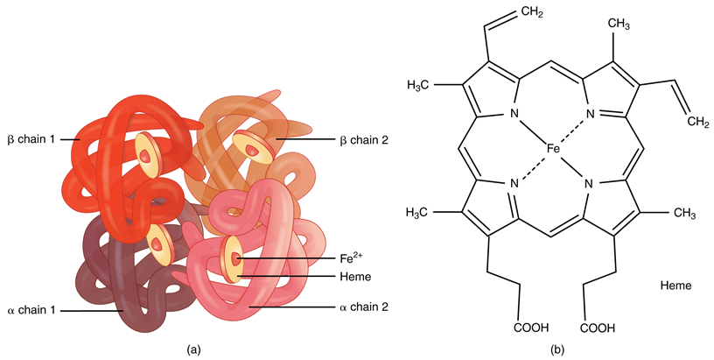
Background: Hemoglobin
Comprised of 4 polypeptide globin chains: 2 alpha and 2 beta chains
Each globin chain is bound to a heme molecule, which contains an iron ion
Each iron ion can bind to one oxygen molecule
One red blood cell can contain as many as 300 million hemoglobin molecules and transport up to 1.2 billion oxygen molecules
https://pediaa.com/what-is-the-function-of-hemoglobin-in-the-human-body/

Slide 8
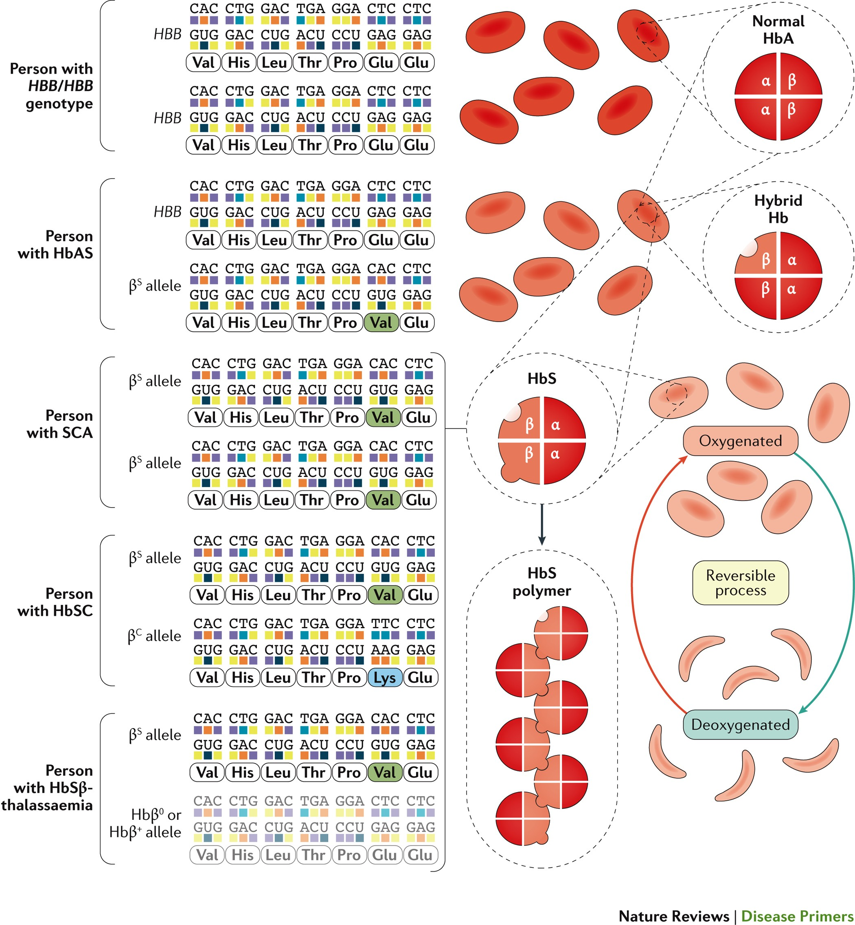
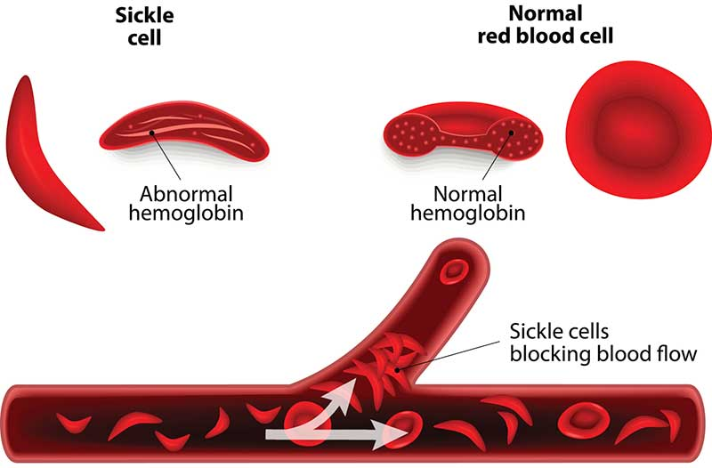
What Causes Sickle Cell Disease?
Caused by a point mutation in the gene that encodes the beta globin chain of hemoglobin
  Substitution of glutamic acid for valine in the sixth codon of chromosome 11
  Leads to production of the mutated hemoglobin, HbS
When HbS is deoxygenated, the hemoglobin can polymerize resulting in the red blood cell assuming the disease’s characteristic “sickle” shape
  Sickled red blood cell is more prone to break down
  Sickled red blood cell is less flexible and can get stuck/block blood vessels

Slide 9
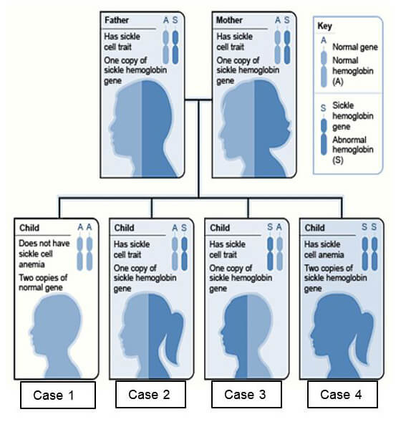
How is Sickle Cell Disease Inherited?
Autosomal recessive pattern of inheritance
  Can inherit the HbS mutation from both parents
  Can inherit the HbS mutation from one parent and another mutation affecting the production of beta globin (i.e. HbSC, HbSβ⁰)
  If a person has only one copy of the HbS mutation, this person has “sickle cell trait”
    Usually has no symptoms
    Can pass on the defective gene to future generations
https://www.ihtc.org/sickle-cell-causes
/

Slide 10
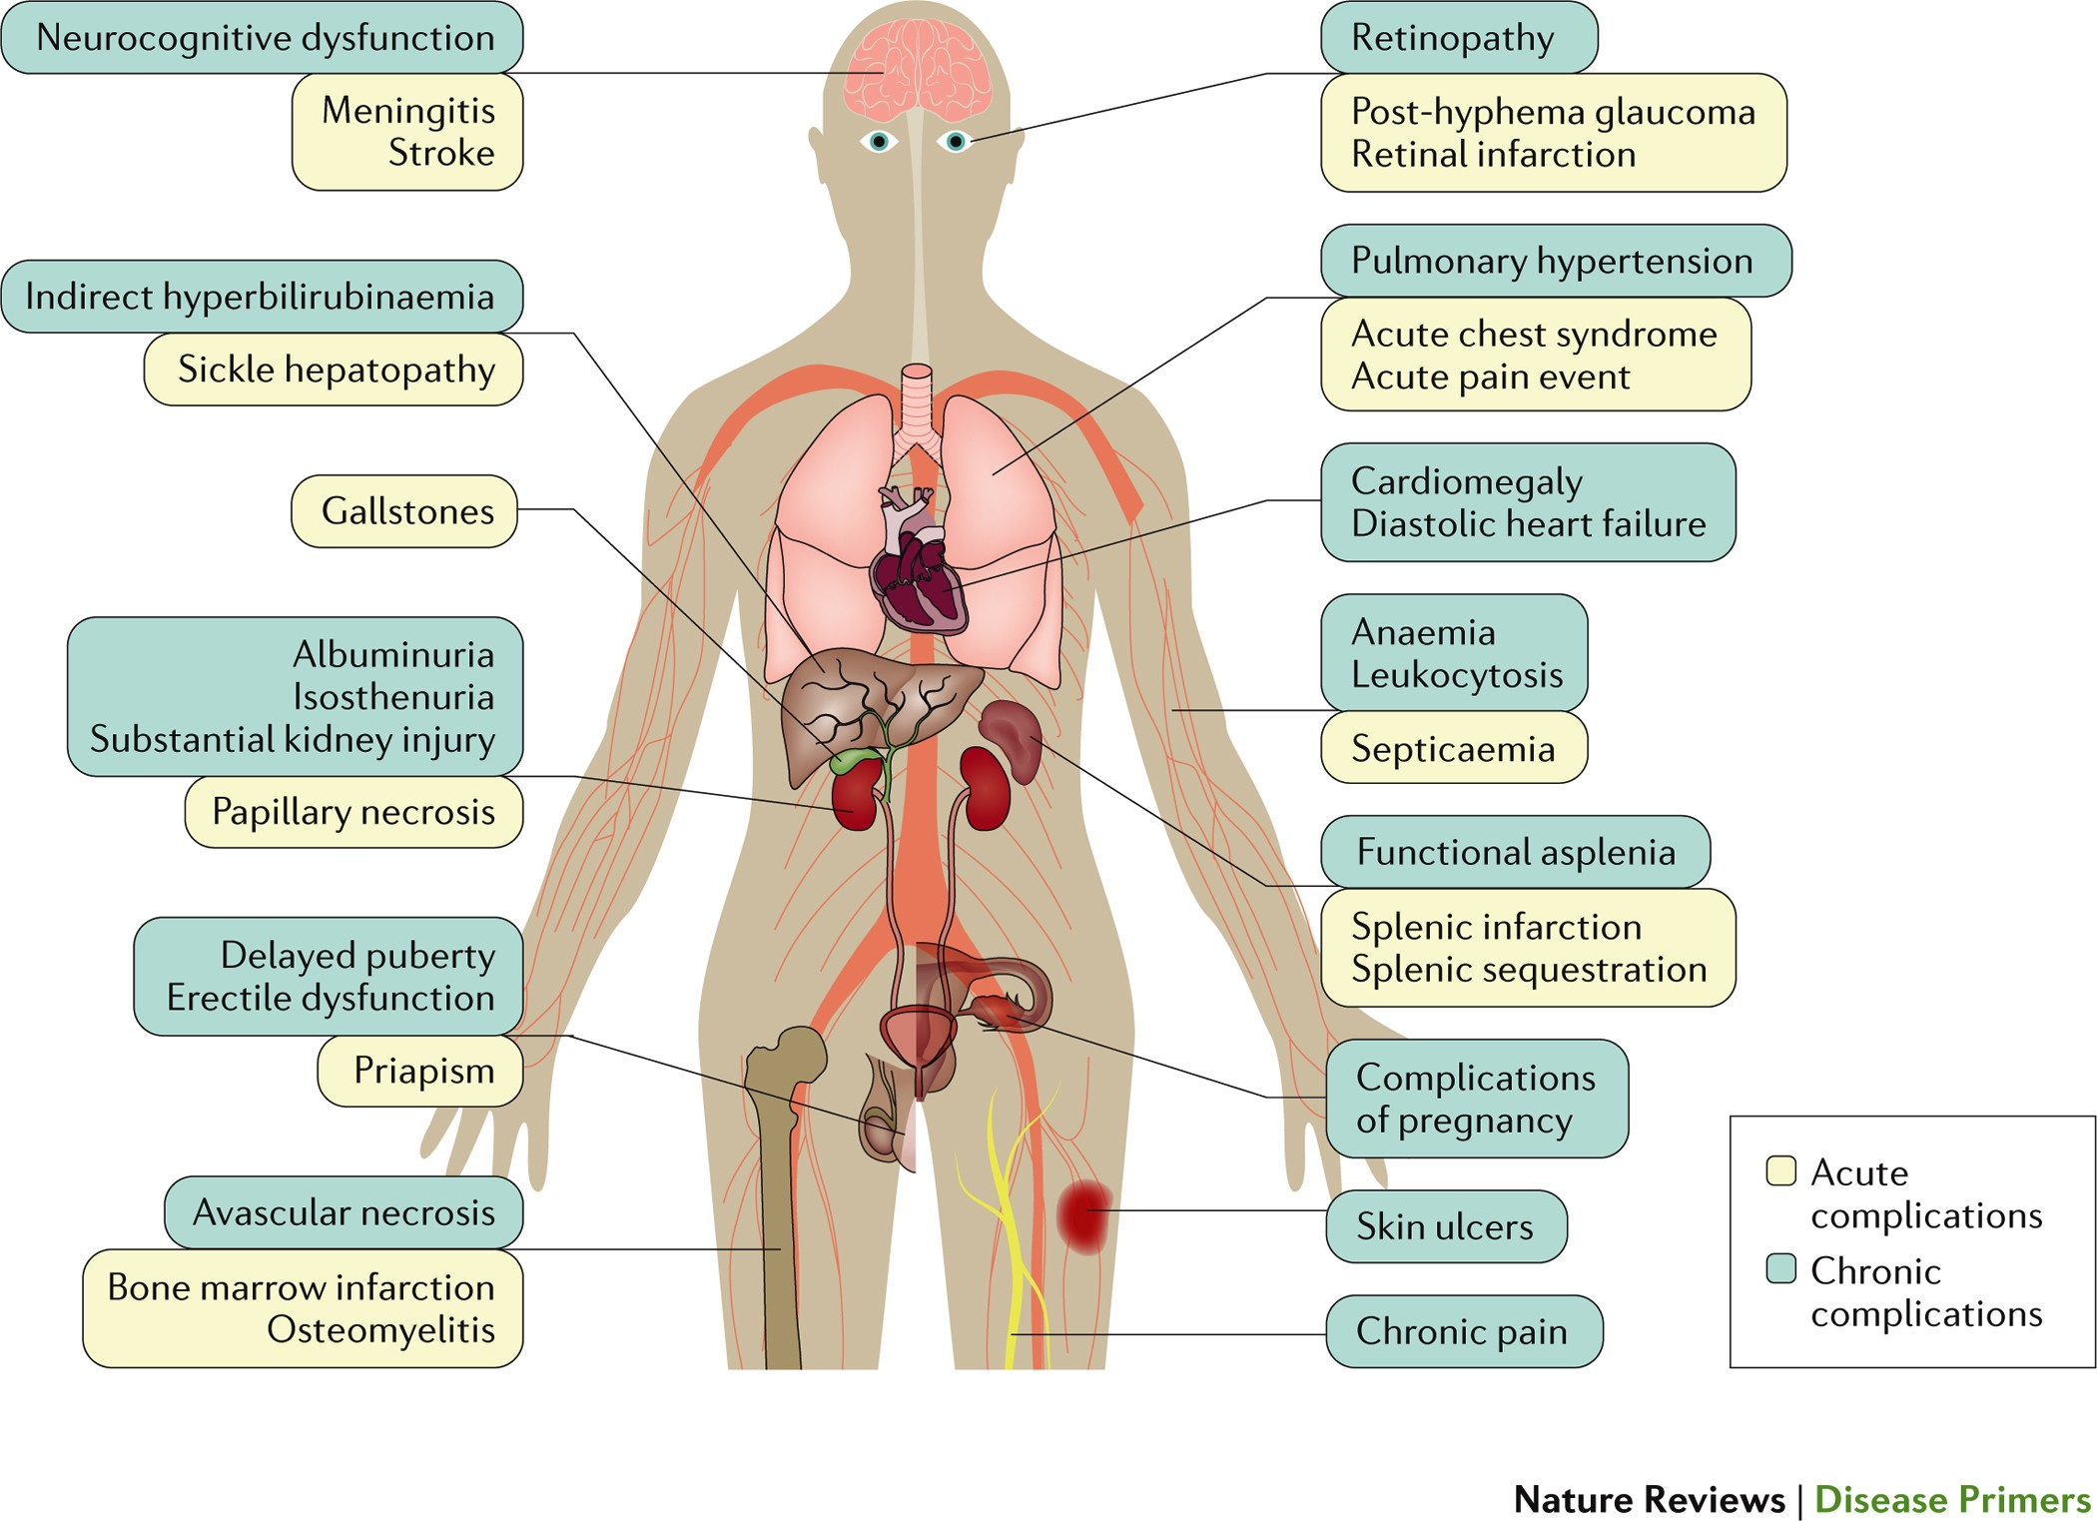
What are the Complications of Sickle Cell Disease?

Slide 11
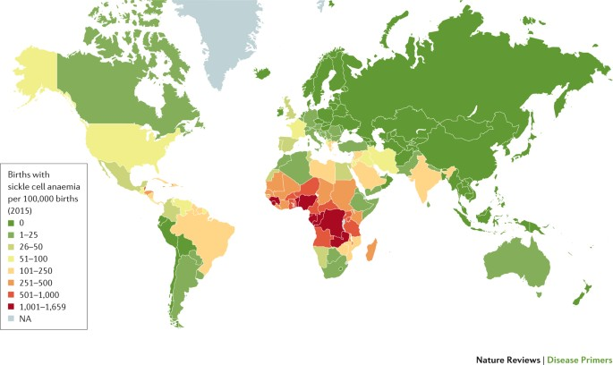
Who Does Sickle Cell Disease Affect?
About 300,000 infants are born with sickle cell disease each year
  75% of these births occur in sub-Saharan Africa
Distribution of the disease is dependent on malaria endemicity and migration
  Sickle cell trait is protective against malaria

Slide 12
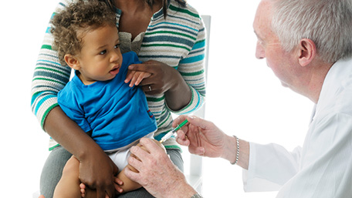
How is Sickle Cell Disease Managed?
Preventative Measures
  Screening
    Newborn screening
    Brain, kidneys, eyes
  Penicillin prophylaxis
  Vaccines
Medications
Transfusions
www.cdc.gov

Slide 13
How is Sickle Cell Disease Managed?
How I approach disease-modifying therapy in children with sickle cell disease in an era of novel therapies. Pediatr Blood Cancer. 2021 Sep 22.

Slide 14
How is Sickle Cell Disease Managed?
Children’s National Medical Center. Hydroxyurea for Sickle Cell Disease. February 2017.
.

Slide 15
How is Sickle Cell Disease Managed?
Preventative Measures
Medications
Transfusions
  Remain an important treatment for acute and chronic complications
  About 90% of adults with sickle cell disease have received a transfusion
  Dilute the amount of HbS, reduce the production of new HbS, increase oxygen saturation and delivery

Slide 16
How is Sickle Cell Disease Managed?
Preventative Measures
Medications
Transfusions
Improved survival of children and adolescents with sickle cell disease. Blood. 2010 Apr 29.
.

Slide 17
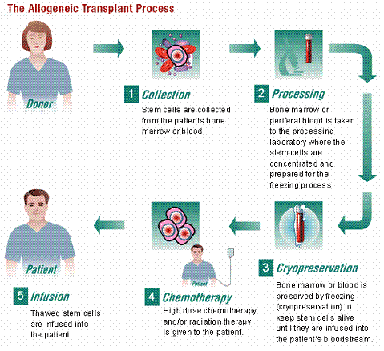
Are There Curative Options for Sickle Cell Disease?
Hematopoietic Stem Cell Transplant
  Overall survival rate and disease-free survival rate are above 90%
  Less than 20% of patients have a matched donor
  Given risks associated with transplant, usually reserved for patients with significant complications from disease
    Risks: graft versus host disease (GVHD), infection, graft rejection
https://safemedtrip.com/medical-services/organ-transplant-in-india/bone-marrow-transplant-in-india.html
.

Slide 18
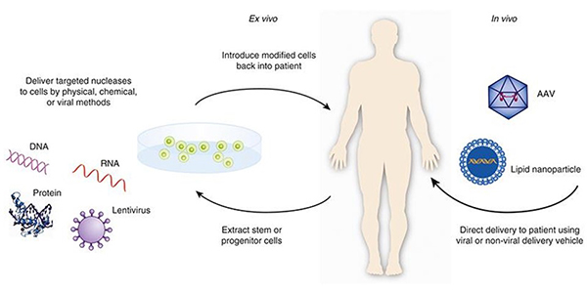
Are There Curative Options for Sickle Cell Disease?
Gene Therapy
www.fda.gov
.

Slide 19
Crisis Management
Fever
Pain
Acute Chest Syndrome
Stroke
Priapism

Slide 20
Fever
Due to functional asplenia, patients with sickle cell disease are at an increased risk of serious bacterial infections
All patients with sickle cell disease should be referred to an emergency room for temperatures >38.5C (101.5F)
Evaluation and management in the emergency room includes:
  Labs
  Blood culture
  Initiation of antibiotics

Slide 21
Pain
Vaso-occlusive pain crises are caused by sickled cells blocking blood flow in the vessels
Pain can occur in the extremities, back, chest, abdomen
  Throbbing, aching, sharp/stabbing
Triggers
  Dehydration, overexertion
  Infection
  Weather
  Emotional stress
Prevention
  Good hydration
  Avoidance of extreme cold or hot temperatures
  Breaks during physical activity

Slide 22
Pain
Mild Pain
  NSAIDs, Tylenol, and/or short acting oral opioids
    Many families have a “home regimen” for early pain
  Rest and fluids
  Local measures
    Warm compresses, massage, distraction
Severe Pain
  If home regimen is not relieving pain, consider referral to the emergency room
  Aggressive upfront pain management is key
    IN fentanyl
    IV Toradol
    IV opioids
    Hydration (not hyperhydration)

Slide 23
Acute Chest Syndrome
Acute chest syndrome is caused by sickled cells blocking blood flow and oxygen from the lungs
Etiology
  Infectious
  Non-infectious (fat emboli from necrotic marrow during a pain crisis, pulmonary emboli)
One of the leading causes of acute death in sickle cell disease

Slide 24
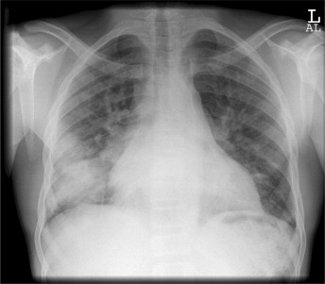
Acute Chest Syndrome
Diagnosis
  New pulmonary infiltrate on chest XR
  Cough, chest pain, hypoxia, tachypnea
Treatment
  Antibiotics
  Incentive spirometry/pulmonary toilet
  Albuterol
  Moderate fluid restriction
  Transfusions in severe cases
www.sciencedirect.com

Slide 25
Stroke
10-12% of children with sickle cell anemia will have a symptomatic stroke (large vessel disease)
  Additional 37% have asymptomatic infarcts by MRI
Signs/Symptoms
  Headache, weakness, numbness, tingling, changes in vision, changes in gait, changes in speech
Rapid action can reverse deficits associated with acute stroke
Treatment
  Exchange transfusion
  Long term management with chronic transfusion therapy

Slide 26
Priapism
Painful persistent erection due to vaso-occlusive obstruction of the venous drainage
  90% of males will have at least one episode by adulthood
Can lead to impotence and is a medical emergency
Stuttering
  Typically resolves on its own
  Ensure adequate hydration
  Oral analgesia if necessary
  Attempt to urinate
  Gentle exercise (walking stairs)

Slide 27
Priapism
If persistent, refer to the emergency room
  Treatment
    IV narcotics and hydration
    Vasoactive agents (oral or injected into corpora cavernosa)
      Epinephrine
    Aspiration and epinephrine irrigation by Urology
    Prevention of future episodes with pseudoephedrine

Slide 28
Thank you!

Slide 29
References
  Engel ER, Howard AL, Ankus EJ, Rico JF. Advances in Sickle Cell Disease Management. Adv Pediatr. 2020 Aug;67:57-71. doi: 10.1016/j.yapd.2020.03.001. Epub 2020 May 14. PMID: 32591064.
  Hoppe C, Neumayr L. Sickle Cell Disease: Monitoring, Current Treatment, and Therapeutics Under Development. Hematol Oncol Clin North Am. 2019 Jun;33(3):355-371. doi: 10.1016/j.hoc.2019.01.014. Epub 2019 Mar 28. PMID: 31030807.
  Karkoska K, McGann PT. How I approach disease-modifying therapy in children with sickle cell disease in an era of novel therapies. Pediatr Blood Cancer. 2021 Sep 22:e29363. doi: 10.1002/pbc.29363. Epub ahead of print. PMID: 34550643.
  Kato GJ, Piel FB, Reid CD, Gaston MH, Ohene-Frempong K, Krishnamurti L, Smith WR, Panepinto JA, Weatherall DJ, Costa FF, Vichinsky EP. Sickle cell disease. Nat Rev Dis Primers. 2018 Mar 15;4:18010. doi: 10.1038/nrdp.2018.10. PMID: 29542687.
  Meier ER. Treatment Options for Sickle Cell Disease. Pediatr Clin North Am. 2018 Jun;65(3):427-443. doi: 10.1016/j.pcl.2018.01.005. PMID: 29803275.
  Piel FB, Steinberg MH, Rees DC. Sickle Cell Disease. N Engl J Med. 2017 Apr 20;376(16):1561-1573. doi: 10.1056/NEJMra1510865. PMID: 28423290.
  Quinn CT, Rogers ZR, McCavit TL, Buchanan GR. Improved survival of children and adolescents with sickle cell disease. Blood. 2010 Apr 29;115(17):3447-52. doi: 10.1182/blood-2009-07-233700. Epub 2010 Mar 1. PMID: 20194891; PMCID: PMC2867259.
  Rees DC, Williams TN, Gladwin MT. Sickle-cell disease. Lancet. 2010 Dec 11;376(9757):2018-31. doi: 10.1016/S0140-6736(10)61029-X. Epub 2010 Dec 3. PMID: 21131035.
  Children’s National Medical Center. Hydroxurea for Sickle Cell Disease. February 2017.

