Slide 1



Electronic Cigarettes:
What you need to know
Panagis Galiatsatos, MD, MHS
Associate Professor of Medicine & Oncology
The Johns Hopkins University School of Medicine

Slide 2
Disclosures
None
Notes:
-What are electronic cigarettes?
-What is inside the chemicals of electronic cigarettes?
-What are the concerns for kids using them?
-Can they be a strategy for adults to stop traditional cigarettes?
-Have you seen any health concerns from electronic cigarettes?
-How does one receive help if they feel they are addicted to electronic cigarettes?

Slide 3
Objectives
To review basic pulmonary physiology as it relates to the inhalation of toxins
To review nicotine addiction from electronic cigarettes
To understand the current status of electronic cigarettes in youth usage

Slide 4
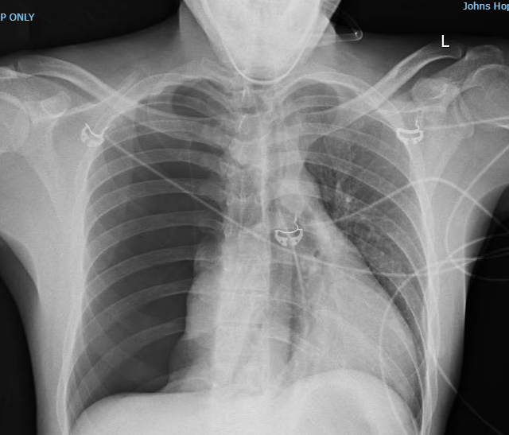
Notes:
22 yo who had a pneumothorax
Plus the aforementioned slides

Slide 5

Quick Case

Slide 6
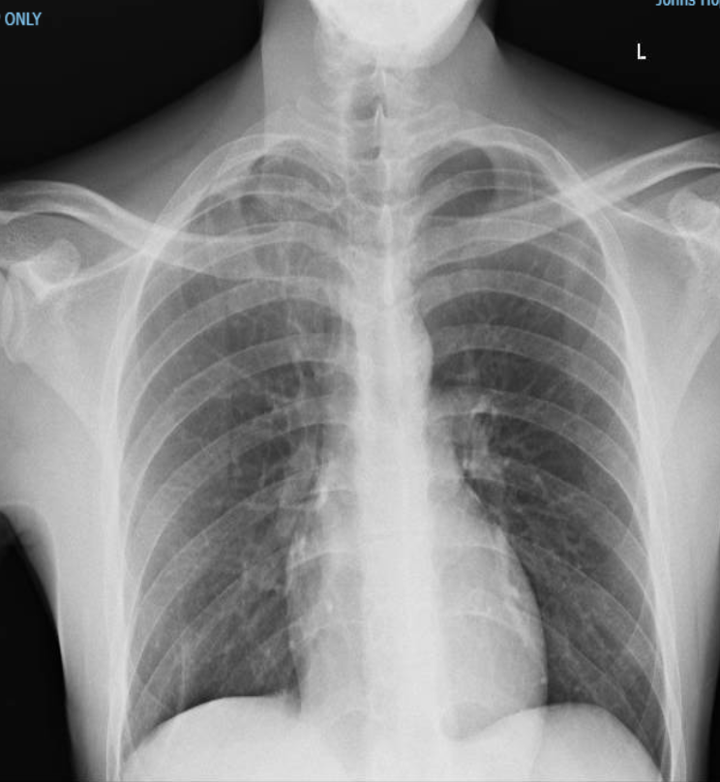
Notes:
22 yo who had a pneumothorax
Plus the aforementioned slides

Slide 7
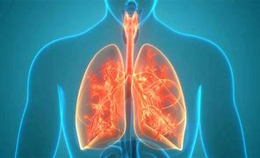
Lungs!

Slide 8

Let’s talk about your lungs
Soccer players.
Basketball players.
Baseball players.

Slide 9
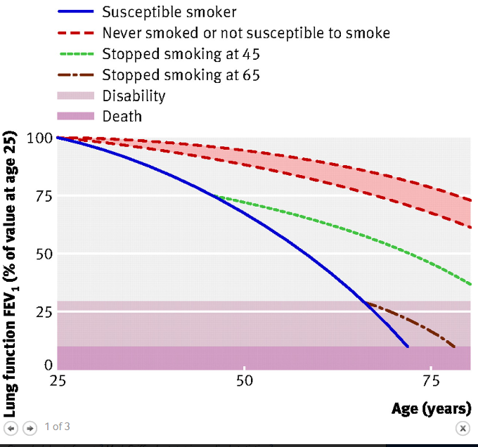
BMJ 2008;336:598

Slide 10
What are electronic cigarettes?

Slide 11
Anatomy of an Electronic Cigarette
Klager et al. Env Sci & Techn. 2017
Notes:
An e-cigarette is a battery-operated nicotine delivery device consisting of a heating chamber and a liquid-containing cartridge. The devices can be purchased with cartridges that are disposed of once empty or as vaporizers with a refillable tank that allows users to create their own mixtures and flavors of e-cigarette fluid. E cigarette liquids are composed of nicotine and flavorings dissolved in a propylene glycol and/or glycerol vehicle.
The glycerol and propylene glycol base is the major constituent of e-cigarette liquid, comprising approximately 80−97% of the e-cigarette liquid by weight.11 When a user draws air through the e-cigarette, the liquid in an e-cigarette is heated, creating an aerosol that is inhaled.
The flavoring compounds, propylene glycol, and glycerol in e-cigarette liquids are approved by the FDA and found on the Generally Recognized as Safe (GRAS) list.12 However, GRAS chemicals are tested and approved for ingestion only, not for inhalation. The GRAS approved flavoring compound diacetyl that is used to create savory, sweet, and fruit flavors is known to produce severe respiratory diseases upon inhalation and has been identified in e-cigarette aerosol in numerous studies.
Based on information from e-cigarette manufacturers, a full e-cigarette cartridge provides approximately 300 puffs.63 These figures
indicate that the average e-cigarette user may be inhaling formaldehyde at concentrations that would be unacceptable in the workplace, and they are doing this nearly 300 times each day. This puts users at a high risk of the upper respiratory tract irritation, eye irritation, and dermal and respiratory sensitization that the ACGIH based its guidelines upon.

Slide 12
What is inside an electronic cigarette?

Slide 13
So… Why DO People Smoke or Vape?
Notes:
ASK THE CLASS TO DEFINE “Addiction”
Words for the class to know: Nicotine
Discuss how it mimics in structure acetylcholine, the most abundant neurotransmitter and thus takes over the acetylcholine receptors
**Because it looks like acetylcholine, it HIJACKS it’s receptors and begins to form an addiction.

Slide 14



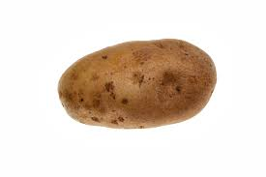
Nicotine

Slide 15
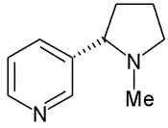
Factors Affecting Cigarette Nicotine Yield
+
Various Chemicals
+
Heat
CH3
a_{fb}^{nic}
pH = pKa + log ( ______ )
1 - a_{fb}^{nic}
Baker RR. Food Chem Toxicol 2004; 42: S3-S37
Notes:
Well documented that ammonia can be added to tobacco products to increase the pH of tobacco.
Increasing the pH shifts the equilibrium of nicotine that is “bound” in nicotine salts to free nicotine
Meaning: when ammonia is added to tobacco, it reacts with indigenous nicotine salts and liberates free nicotine
-Increasing levels of free-based nicotine smoke leads to an increased bioavailability of nicotine
More bioavailability of nicotine, more likely to drive addictions and reinforce addiction
A_{fb}^{nic} = free-based nicotine

Slide 16

Even products with 0 nicotine, tobacco alkaloids, like anabasine, may be added to sustain the addiction
https://www.premiumecigarette.com/

Slide 17
Anatomy of an Electronic Cigarette
Klager et al. Env Sci & Techn. 2017
Notes:
Emphasize there is a “heating coil”, battery, and chemicals
- Heat + chemicals CAUSES nicotine to become CHEMICALLY ENHANCED (the –CH3, methyl group, is removed)

Slide 18
Anatomy of an Electronic Cigarette
CONTENTS
Nicotine
Propylene glycol and/or glycerol
Flavorings / Diacetyl
Formaldehyde
Klager et al. Env Sci & Techn. 2017
Notes:
You can introduce

Slide 19
Anatomy of an Electronic Cigarette
CONTENTS
Note many of these chemicals
are approved by the FDA
Generally Recognized as Safe list (GRAS)
BUT
Klager et al. Env Sci & Techn. 2017

Slide 20
Anatomy of an Electronic Cigarette
CONTENTS
GRAS list compounds are tested and
approved for INGESTION only,
not for inhalation
Klager et al. Env Sci & Techn. 2017

Slide 21



For instance
Notes:
Words for the class to know: Diacetyl
All these foods contain diacetyl
Ask the kids how many people have eaten these foods? Ask them what brand of pop tarts they like!

Slide 22
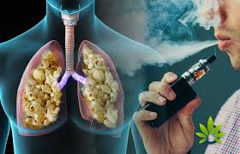
Anatomy of an Electronic Cigarette
CONTENTS
Diacetyl – a flavoring used in electronic
cigarettes.
Used in popcorn flavoring, Pop Tarts,
candy corn
Fixed Obstructive Lung Disease in Workers at a Microwave Popcorn Factory --- Missouri, 2000—2002
CDC MMWR April 2002
Notes:
Talk about how Diacetyl was inhaled by factory workers at a pop corn factory, leading to bronchiolitis obliterans (then known as pop corn lung).
B.O. has a 95% mortality rate at 5-years

Slide 23

For instance
CONTENTS
Formaldehyde – used to prepare DEAD bodies; NOT SAFE to breathe in at HIGH LEVELS
**These levels are high in e-cigarettes
Notes:
Words for the class to know: Formaldehyde
All these foods contain diacetyl
Ask the kids how many people have eaten these foods? Ask them what brand of pop tarts they like!

Slide 24
Anatomy of an Electronic Cigarette
CONTENTS
Metals
Volatile Organic Compounds
Tobacco Alkaloids
Polycyclic Aromatic Hydrocarbons
Klager et al. Env Sci & Techn. 2017
https://www.atsdr.cdc.gov/mmg/mmg.asp?id=216&tid=39
Notes:
The flavoring compounds, propylene glycol, and glycerol in e-cigarette liquids are approved by the FDA and found on the Generally Recognized as Safe (GRAS) list.12 However, GRAS chemicals are tested and approved for ingestion only, not for inhalation. The GRAS approved flavoring compound diacetyl that is used to create savory, sweet, and fruit flavors is known to produce severe respiratory diseases upon inhalation and has been identified in e-cigarette aerosol in numerous studies.
Based on information from e-cigarette manufacturers, a full e-cigarette cartridge provides approximately 300 puffs.63 These figures
indicate that the average e-cigarette user may be inhaling formaldehyde at concentrations that would be unacceptable in the workplace, and they are doing this nearly 300 times each day. This puts users at a high risk of the upper respiratory tract irritation, eye irritation, and dermal and respiratory sensitization that the ACGIH based its guidelines upon.
solvent carriers (PG and glycerol), tobacco-specific nitrosamines (TSNAs), aldehydes, metals, volatile organic compounds (VOCs), phenolic compounds, polycyclic aromatic hydrocarbons (PAHs), flavorings, tobacco alkaloids, and drug
Toxicology of E-Cigarette Constituents - Public Health Consequences of E-Cigarettes - NCBI Bookshelf (nih.gov)

Slide 25
Anatomy of an Electronic Cigarette
VOCs include a variety of chemicals, some of which may have short- and long-term adverse health effects.
Examples include: paints and lacquers, paint strippers, cleaning supplies, pesticides, building materials and furnishings, office equipment such as copiers and printers, correction fluids and carbonless copy paper, graphics and craft materials including glues and adhesives, permanent markers, & photographic solutions.

Slide 26
Electronic Cigarettes
HIGHLY ADDICTING
DANGEROUS CHEMICALS THAT LEAD to both immediate lung issues and long term health complications.

Slide 27
What are some concerns for children and electronic cigarettes?

Slide 28




Notes:
Many studies are finding that these products cause harm to children now: chronic cough, asthma, bronchitis, frequent infections. Above are some of the published data to date. These outcomes concern us because they seem to follow along the same trajectory as traditional cigarettes. Meaning, if these youth vape now, these symptoms, though reversible in the present, become future diseases like emphysema, chronic bronchitis, and COPD decades later (just like traditional cigarettes).

Slide 29
ACETYLCHOLINE
Notes:
Ask them to define “addiction”
Words for the class to know: Acetylcholine

Slide 30
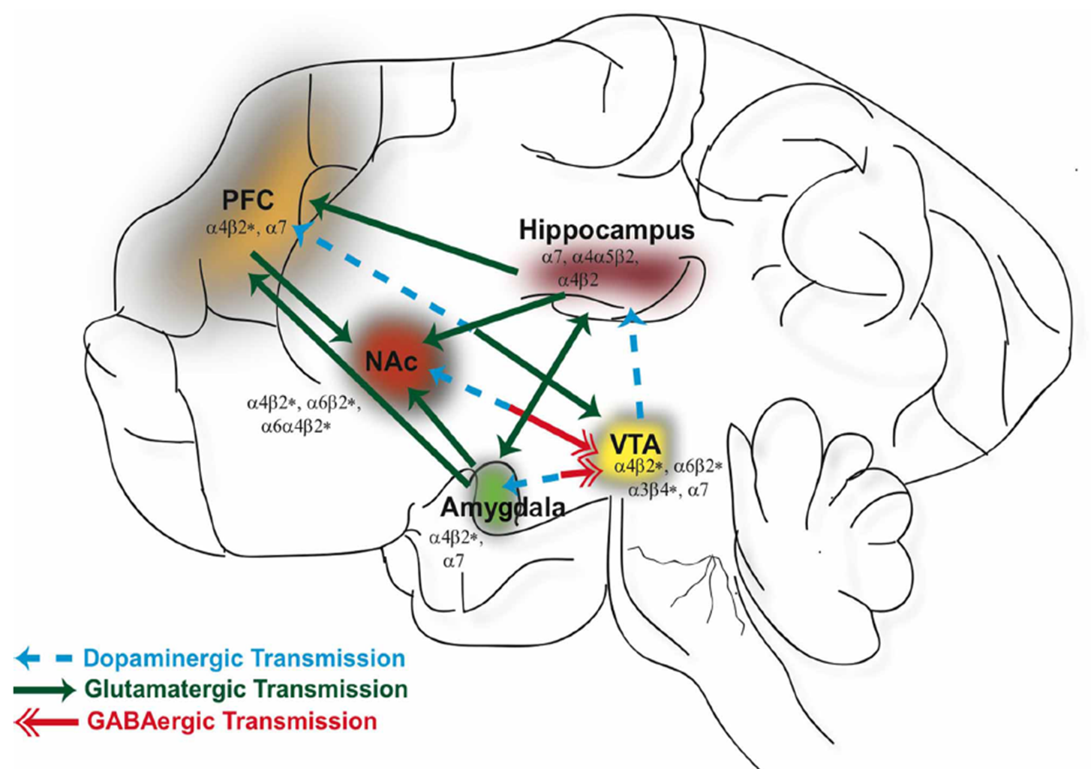
Notes:
Nicotine drives addiction by RE-WIRING the “Pre-frontal Cortex”
Words for the class to know: Pre-frontal Cortex
**It drives our behaviors for things like “eating” and “sleeping”
AT WHAT AGE DOES THE PREFRONTAL CORTEX STOP FORMING = 25 → this is why they target youth! It’s more likely you’ll be become addicted and STAY ADDICTED!!
*If they can get you to vape before 25, you’ll be addicted for the rest of your life!!!!

Slide 31
Enhancing the “Gratification Factor”
Thalamus
Striatum
Negative Prediction Error
DA
VTA
Core
DA
Shell
Nuc Accum
nACh
Shell = Drug Seeking Behavior
Core = Gratification of Compulsion
Notes:
AND PERMANENT ADDICTION

Slide 32
Where are we?

Slide 33
Youth Usage of Electronic Cigarettes
In the United States, youth use e-cigarettes, or vapes, more than any other tobacco product.
No tobacco products, including e-cigarettes, are safe, especially for children, teens, and young adults.
E-cigarette marketing, the availability of flavored products, social influences, and the effects of nicotine can influence youth to start or continue vaping

Slide 34
Youth Usage of Electronic Cigarettes
In 2024, e-cigarettes were the most commonly used tobacco product among middle and high school students in the United States:
1.63 million (5.9%) students currently used e-cigarettes. This includes:
  410,000 (3.5%) middle school students.
  1.21 million (7.8%) high school students
CDC MMWR October 2024

Slide 35
Youth Usage of Electronic Cigarettes
In 1984, cigarettes were the most commonly used tobacco product among middle and high school students in the United States:
  5.4% middle school students.
  25% high school students
Pampel FC, Aguilar J. Changes in Youth Smoking, 1976-2002: A Time-Series Analysis. Youth Soc. 2008;39(4):453-479. doi: 10.1177/0044118X07308070. PMID: 19652692; PMCID: PMC2696267.

Slide 36
How to prevent a new generation of becoming addicted to this new tobacco product?

Slide 37
How to prevent a new generation of becoming addicted to this new tobacco product?
Communicate the risk
Knowledge > Marketing
Community
Assistance for those who may become or are addicted

Slide 38
What should one do if they are addicted to electronic cigarettes?

Slide 39
Stopping vaping
Talk with your clinician
Talk to trusted adults
Form a support group
Recognize it is a journey – stopping does not mean permanently being off of the product. Be prepared for a journey of managing future cravings.

Slide 40
Notes:
22 yo who had a pneumothorax
Plus the aforementioned slides

Slide 41
QUESTIONS
Additional thoughts or comments: dr.g@jhmi.edu
Referrals to the Tobacco Treatment Clinic can be emailed to tobacco@jhmi.edu
Request for E-Cigarette School-based curriculum: heatcorps@jhu.edu

