Slide 1
Pediatric asthma: review, current guidelines, SMART, advocacy, and more
Maryland Assembly on School-Based Health Care Webinar
S. Christy Sadreameli, MD MHS
Johns Hopkins- Pediatric Pulmonology
September 24, 2024

Slide 2
Disclosures
No conflicts of interest to disclose
Off-label use of medication (SMART) that is consistent with US and international asthma guidelines

Slide 3
Overview
Asthma basics- epi, pathophysiology, classification, treatment
Asthma guidelines (NIH and GINA)- SMART and more
SMART at school
Advocacy/policy and how it relates to school health: stock albuterol, inhaler access and affordability

Slide 4
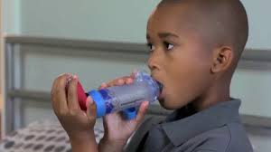
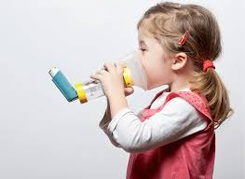
Epidemiology: USA
Asthma is the most common chronic disease in childhood in resource-rich countries
As of 2019, approximately 10.5% of US children <18 yrs (~7.7 million) have ever had asthma, current estimate: 6.5%
Leading cause of school absenteeism in those <15 yrs
2013: estimated 13.8 million lost school days in school-aged children with an asthma flare-up in the previous year
Third leading cause of hospitalization among children <15 yrs
CDC National Center for Health Statistics 2019
American Lung Association 2020
Notes:
In 2016, 3,651 deaths were attributed to asthma, 169 were children under 15
In 2010, there were approximately 640,000 ED visits for asthma management in children under 15
Asthma results in $80 billion annually in medical expenses, days missed from work/school and deaths
Asthma is one of the leading causes of school absenteeism; in 2013, asthma accounted for an estimated 13.8 million lost school days in school-aged children with an asthma flare-up in the previous year
Asthma is the third leading cause of hospitalization in children under 15

Slide 5
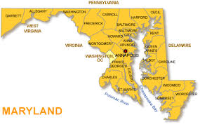
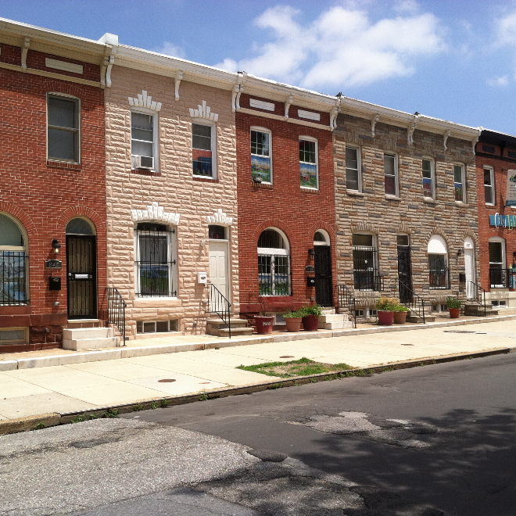
Maryland/Baltimore Asthma Prevalence
NATIONAL
STATE
6.5% (children)
7.6%
BALTIMORE CITY
Asthma ED visits
by neighborhood
Approximately 20% of kids

Slide 6
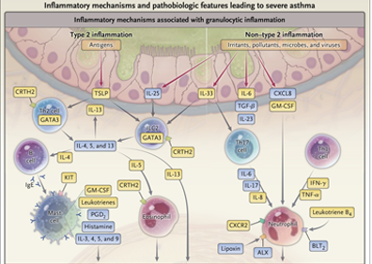
Pathophysiology
What three main pathophysiologic features associated with asthma?
Lower Airway inflammation
Eosinophilic predominance (allergic)
Other pathways also involved
Airway hyperreactivity
Bronchospasm- airway constriction with stimulus
(viral infection, inhaled allergen, cold air,
hypertonic saline)
Reversible lower airway obstruction
Responds to bronchodilator
Israel E, Reddel HK. N Engl J Med 2017;377:965-976
Notes:
Kimmy
Asthma is a chronic inflammatory disorder of the lower airways in which inflammatory cells (mast cells, eosinophils, neutrophils), chemical mediators (histamine, leukotrienes, platelet-activating factor) and chemotactic factors (cytokines) all play a role.
airway inflammation is believed to be the primary underlying mechanism causes airway hyper-responsiveness (bronchoconstriction/bronchospasm) and lower airway obstruction, as well as edema, mucus production and recruitment of inflammatory cells into the airway.

Slide 7
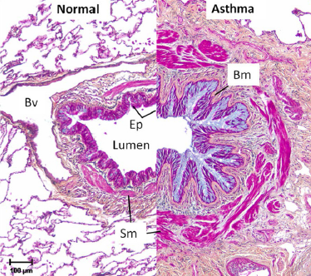
Pathophysiology
Chronic inflammation → airway remodeling
Basement membrane thickening, epithelial cell injury,
angiogenesis, and smooth muscle hypertrophy
and hyperplasia
Airway remodeling → irreversible structural changes and progressive loss of pulmonary function (↓FEV₁, ↓FEV₁/FVC ratio)
Although anti-inflammatory medicines such as inhaled corticosteroids (ICS) control asthma exacerbations, they do not appear to mitigate progression of disease
Individual patients demonstrate variability in their patterns of inflammation, likely related to genetics, which has implications for the effectiveness of therapies
Diagnosis based on symptom pattern over time, response to therapy, pulmonary function tests
Notes:
Kimmy
Asthma is a chronic inflammatory disorder of the lower airways in which inflammatory cells (mast cells, eosinophils, neutrophils), chemical mediators (histamine, leukotrienes, platelet-activating factor) and chemotactic factors (cytokines) all play a role.
airway inflammation is believed to be the primary underlying mechanism causes airway hyper-responsiveness (bronchoconstriction/bronchospasm) and lower airway obstruction, as well as edema, mucus production and recruitment of inflammatory cells into the airway.

Slide 8
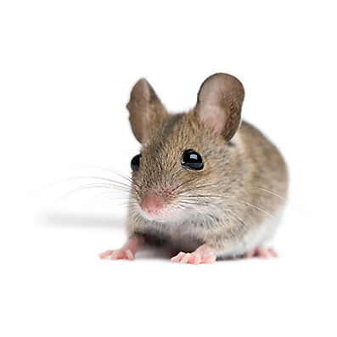
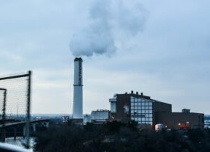
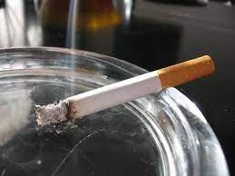
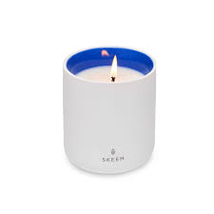
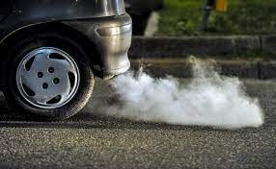
Asthma triggers
Factors that lead to bronchospasm and symptoms
Triggers may overlap and contribute to episodes (example: a respiratory virus during someone’s peak allergy season, exposure to secondhand smoke + another trigger)
Tobacco smoke
Viruses (rhinovirus + more)
Pests
Pollen/allergens
Air pollution- particulate matter (trash incinerator)
Air pollution- ozone (forms in atmosphere)
Candles/irritants

Slide 9
Classification of Asthma Severity
 |  | Persistent | Very Poorly Controlled
 | Intermittent | Mild | Moderate | Severe
Symptoms | ≤2 days/week | >2 days/week but not daily | Daily | Throughout the day
Nighttime awakenings | ≤2x/month | 3-4x/month | >1x/week but not nightly | Often 7x/week
Interference with normal activity | None | Minor limitation | Some limitation | Extremely limited
SABA Use for symptom control | ≤2 days/week | >2 days/week but not daily | Daily | Several times per day
Lung Function | FEV₁ >80% predicted FEV₁/FVC >85% Normal FEV₁between exacerbations | FEV₁ ≥80% predicted FEV₁/FVC >80% | FEV₁ 60-80% predicted FEV₁/FVC 75-80% | FEV₁ <60% predicted FEV₁/FVC <75%
Exacerbations requiring oral systemic corticosteroids | 0-1/year | ≥2 in 1 year
Adapted from Figure 3-4b NAEPP 2007
Notes:
Kimmy
How we assess severity
So thinking again about Timmy..

Slide 10
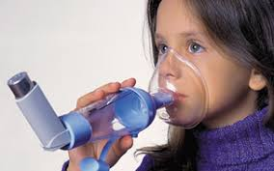
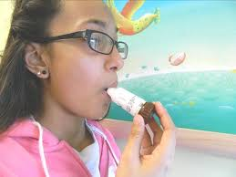
Asthma medication delivery
Nebulizer:
Use with face mask or mouthpiece
Benefits:
No need to coordinate breathing with actuation
Drawbacks:
Time-intensive
A lot of drug delivered elsewhere (stomach, etc)
Increased side effects, decreased efficacy
Metered-dose inhaler (MDI):
Use a propellant (HFA) to deliver a consistent dose, no matter how much is left in container
Benefits:
All ages can use
Needs spacer
Drawbacks:
Insurance coverage/med availability
Inconsistent spacer use
Climate concerns
Dry powder inhaler (DPI):
Use a strong, controlled inhale to deliver the medication
Benefits:
No spacer required
No propellant (climate-friendly)
Drawbacks:
Requires strong inhale, breath hold
Many kids can’t do
Ages 4+ (FDA), 7-8 minimum (reality)

Slide 11
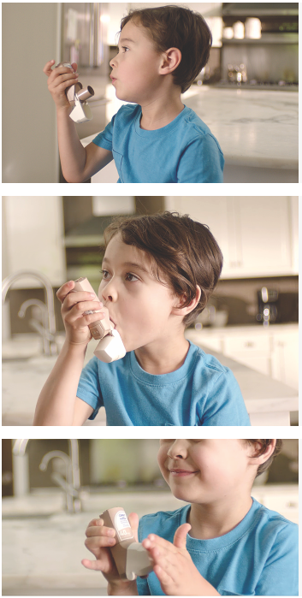
QVAR Redihaler® breath actuated inhaler- a type of dry powder inhaler (DPI) FDA indication: 4+ years (you make the call…)
Step 1: Breathe out fully
Step 2: Without a spacer, place your lips around the opening to create a tight seal. Don’t cover the air vent on top. Inhale deeply and hold your breath for 10 seconds.
Step 3: Close the cap and do it again if necessary
Consider these (and other DPI) in selected patients starting at age 7-8, maybe older
Pros: no spacer needed, no propellant (climate-friendly)

Slide 12
Medication delivery based on method
Medication deposition:
nebulizer (left)
vs.
inhaler/spacer (right)
Who needs spacers?
Anyone using metered-dose inhalers
Who needs metered-dose inhalers?
Infants and (young) children
People of any age with cognitive or neurological differences
People with tracheostomies

Slide 13
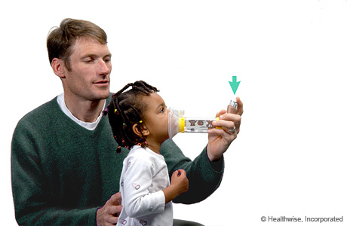
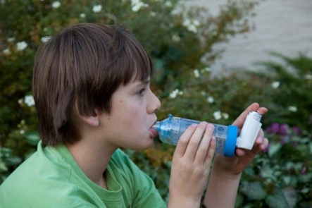
Medication Technique: spacers Spacers
Face mask (birth- age 5/6 or indefinitely if developmentally delayed)
Should fit around nose and chin, no overhang
Actuate 1 puff into chamber when child breathing quietly
6-8 breaths/actuation, 1 min. btw puffs
Infant-small toddler
Most of childhood
Only if needed
Mouthpiece
Actuate, steady/slow breath in, hold for 10 seconds
1 minute between puffs
If it whistles, slow down.
CHECK technique often: errors often occur within 4-6 weeks
Repetition, clinic demos. “Can you show me how you use your inhaler?”

Slide 14
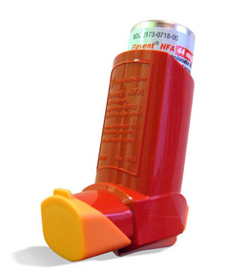
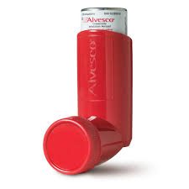
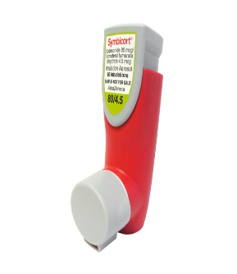
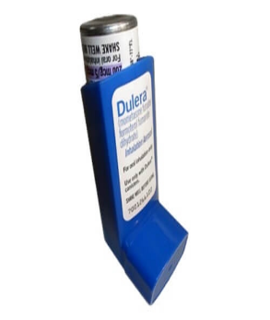
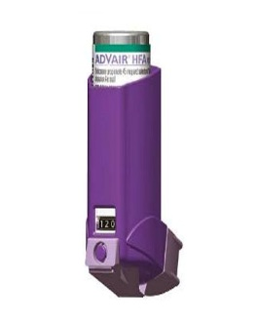
Metered-dose inhaler controller meds now available
Inhaled corticosteroids
ICS/LABA
With formoterol (±SMART)
Symbicort (budesonide/formoterol)
Dulera (mometasone/formoterol)
With salmeterol
Advair* (fluticasone/salmeterol)
*comes in DPI (diskus) too
Fluticasone propionate (Flovent, but generic)
Asmanex (mometasone)*
Alvesco (ciclesonide)
12 and older in US
*Comes in DPI (twisthaler) too

Slide 15
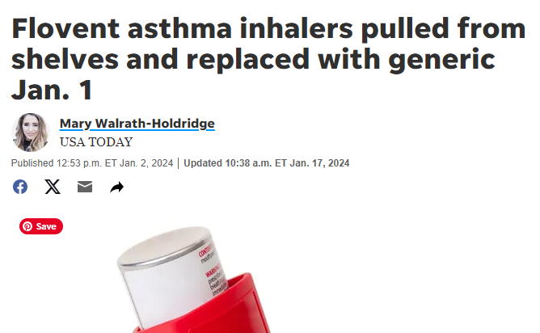
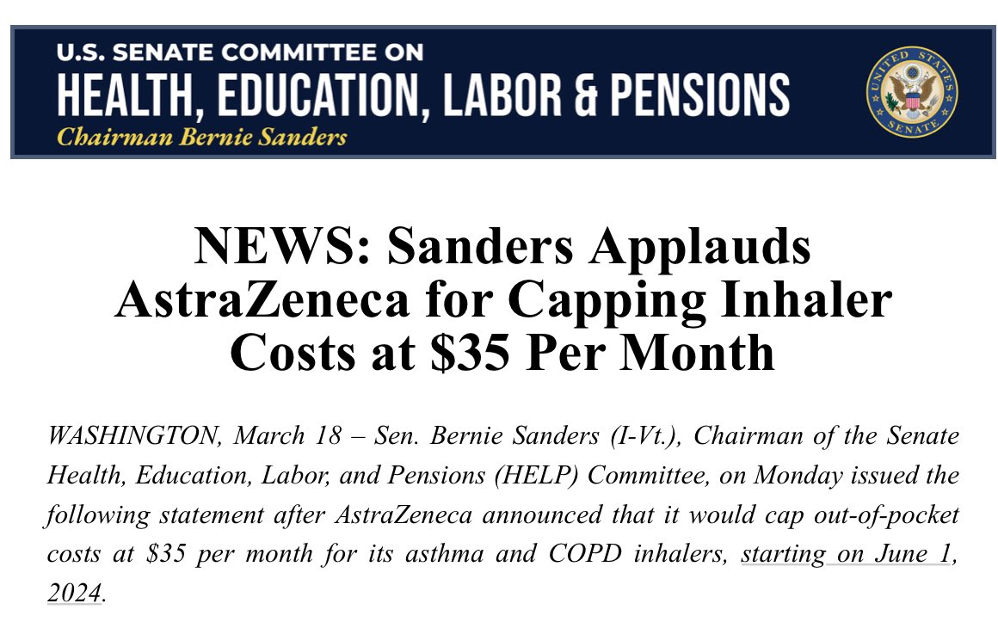
Advocacy: Inhaler pricing, availability

Slide 16
Pricing/availability (continued)
Flovent (brand name) discontinued Jan 1, 2024 by GSK
Replaced by generic (fluticasone proprionate) made in the same GSK factory but now sold by a different company (Prasco)
This unleashed havoc:
This made the drug more expensive for insurers
Many insurers dropped Flovent/fluticasone from their formularies
The next alternative (Asmanex/mometasone) went on shortage within two weeks
Currently:
Insurance coverage a little better
Some kids are having trouble getting an age-appropriate inhaler covered
Some families are paying high copays
Price caps exist for SOME meds, not all, many loopholes
Some students you meet may be on the wrong medication (5,6 year old with a dry powder inhaler not using properly)
Access to other meds, including SMART, also jeopardized
Be aware of these issues when meeting kids in school! A lot of these meds are given at home (controllers). For now, paperwork, prior auth usually successful

Slide 17
Notes:
NOTE: this slide is also repeated later, with slides about remission

Slide 19
SMART/MART
Definition: (Single) maintenance and reliver therapy
Rationale: Longer-acting beta agonist (formoterol)- provides relief within 2-3 min, longer acting (up to 12 hours)
Paired with anti-inflammatory (inhaled steroid)
1-2 puffs can be used as needed, also pre-medication before sports/gym. Max daily dose varies by age
Brand names for this: Symbicort (budesonide/formoterol), Dulera (mometasone/formoterol)
Advair (fluticasone/salmeterol) NOT safe or effective for SMART

Slide 21
Stepwise management GINA (≤ 5 years old) & NHLBI (≤ 4 years old)
Reference: 1, 2
 | GINA (≤ 5 years old) |  | NIH (≤ 4 years old)
Step 1 | PRN SABA | Step 1 | PRN SABA & at the start of RTI: Add short course daily ICS
Step 2 | Daily low dose ICS | Step 2 | Daily low-dose ICS
Step 3 | Double low-dose ICS | Step 3 | Daily low-dose ICS-LABA
Step 4 | Refer to specialist | Step 4 | Daily medium-dose ICS-LABA
 |  | Step 5 | Daily high-dose ICS-LABA
 |  | Step 6 | Daily high-dose ICS-LABA + oral systemic corticosteroid
RECOMMEND:
Short (7–10 day) course of daily ICS w/ PRN SABA at the onset of RTI.
* Recurrent wheezing is defined as at least three episodes of wheezing triggered by apparent infection in their lifetime, or two episodes in the past year, and no symptoms between infections.
Alternative
Intermittent short-course of ICS during concern for respiratory tract infections (RTIs)
Notes:
Page 160: GINA
https://www.clinicalkey.com/#!/content/playContent/1-s2.0-S2213219820308114?returnurl=https:%2F%2Flinkinghub.elsevier.com%2Fretrieve%2Fpii%2FS2213219820308114%3Fshowall%3Dtrue&referrer=https:%2F%2Fpubmed.ncbi.nlm.nih.gov%2F

Slide 22
Stepwise management GINA (6-11 years old) & NHLBI (5-11 years old)
PRN “SMART” [single maintenance & reliever therapy]:
ICS-formoterol 1 to 2 puffs as needed up to a
maximum total daily maintenance and rescue dose of 8 puffs (36 mcg)
Individuals with a severe exacerbation in the prior year are particularly good candidates for SMART to reduce exacerbations.
Do not use ICS-formoterol as reliever therapy in individuals taking ICS-salmeterol as maintenance therapy.
Individuals whose asthma is uncontrolled on maintenance ICS-LABA with SABA as quick-relief therapy should receive the preferred SMART if possible before moving to a higher step of therapy.
Reference: 1,2
 | GINA (6-11 years old) |  | NHLBI (5-11 years old)
Step 1 | PRN low dose ICS + SABA | Step 1 | PRN SABA
Step 2 | Daily low dose ICS + PRN SABA | Step 2 | Daily low-dose ICS and PRN SABA
Step 3 | Low dose ICS-LABA or medium dose ICS or very-low dose SMART | Step 3 | Daily and PRN combination low-dose ICS-formoterol(smart)
Step 4 | Medium dose ICS-LABA or low-dose SMART (Refer to asthma specialist) | Step 4 | Daily and PRN combination medium-dose ICS-formoterol (smart) (Refer to asthma specialist)
Step 5 | Refer for laboratory assessment ± add-on therapy (high dose ICS+LABA, LAMA ± asthma biologics) | Step 5 | Daily high-dose ICS-LABA and PRN SABA (Assess need for asthma biologics)
 |  | Step 6 | Daily high-dose ICS-LABA + oral Systemic corticosteroid and PRN SABA (Assess need for asthma biologics)
PRN “SMART” [single maintenance & reliever therapy]:
ICS-formoterol 1 to 2 puffs as needed up to a
maximum total daily maintenance and rescue dose of 8 puffs (36 mcg)

Slide 23
Stepwise management GINA & NHLBI (≥12 years old)
“SMART” [single maintenance & reliever therapy]:
ICS-formoterol 1 to 2 puffs as needed up to a
maximum total daily maintenance and rescue dose of 12 puffs (54 mcg)
Individuals with a severe exacerbation in the prior year are particularly good candidates for SMART to reduce exacerbations.
Do not use ICS-formoterol as reliever therapy in individuals taking ICS-salmeterol as maintenance therapy.
Individuals whose asthma is uncontrolled on maintenance ICS-LABA with SABA as quick-relief therapy should receive the preferred SMART if possible before moving to a higher step of therapy.
Reference: 1,2
 | GINA |  | NHLBI
Step 1 | PRN low-dose ICS-formoterol | Step 1 | PRN SABA
Step 2 | PRN low-dose ICS-formoterol | Step 2 | Daily low-dose ICS and PRN SABA or PRN combination ICS and SABA
Step 3 | Low dose + PRN ICS-LABA (SMART) | Step 3 | Daily and PRN combination low-dose ICS-formoterol (SMART)
Step 4 | Medium dose ICS-LABA (Refer to asthma specialist) | Step 4 | Daily and PRN combination medium-dose ICS-formoterol (SMART) (Refer to asthma specialist)
Step 5 | Add LAMA and consider high-dose ICS-LABA (Refer for laboratory assessment ± biologics) | Step 5 | Daily medium-high-dose ICS-LABA + LAMA and PRN SABA (Assess need for asthma biologics)
 |  | Step 6 | Daily high-dose ICS-LABA (± oral systemic corticosteroid) and PRN SABA (Assess need for asthma biologics)
PRN combination ICS + SABA
One approach to intermittent therapy is two to four puffs of albuterol followed by 80–250 mcg of Qvar® equivalent every 4 hours as needed for asthma symptoms.
Individuals with either low or high perception of symptoms may not be good candidates for as-needed ICS therapy. Daily low-dose ICS with as-needed SABA may be preferred.
Notes:
Page 60 & 61 - GINA

Slide 24
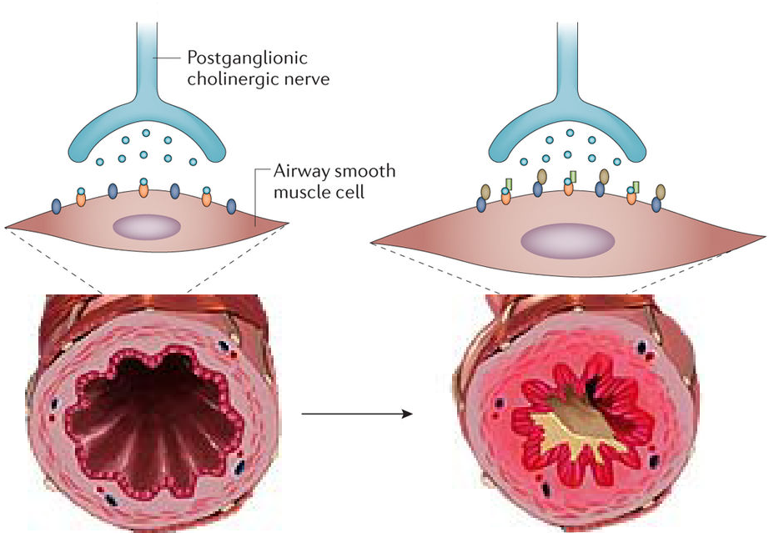
Other guidelines updates (NAEPP/USA): LAMA FDA indication: 6+ years (you make the call…)
Long-acting muscarinic antagonists (LAMA)
Ex: Spiriva Respimat (tiotropium bromide)
Indications: Add-on therapy to ICS/LABA
Failure of LABA/ICS
Dosing:
2 puffs once daily (1.25 mcg)
2 puffs=2.5 mcg
Adverse effects
Dry mouth/sore throat
Worsening sinus congestion
Headaches

Slide 25
Other guidelines updates (NAEPP/USA): intermittent inhaled steroids FDA indication: 6+ years (you make the call…)
Target population: 0–4 years, recurrent wheezing:
At least three episodes of wheezing triggered by apparent infection in lifetime
OR
Two episodes in past year
No symptoms between
If symptoms are more persistent, child older than 4, or severe episodes have recently occurred- likely not appropriate

Slide 26
Other guidelines updates (NAEPP/USA): approach to allergens
Indoor allergen mitigation may be helpful for sensitized patients
Examples: mattress/pillow covers (dust mite allergy), integrated pest management (cockroach or mouse allergy)
Subcutaneous allergen immunotherapy (SCIT)- allergy shots
5 and older, mild to moderate persistent allergic asthma with specific sensitivities- consider as treatment adjunct
SCIT NOT recommended for severe asthma
SLIT (sublingual immunotherapy) not recommended

Slide 27
Other NAEPP guidelines-based updates
Leukotriene antagonists (like montelukast/Singulair) are no longer top tier recommendations (side effects, +/- efficacy)
Fractional exhaled nitric oxide monitoring
5 years and older, trying to confirm diagnosis of allergic asthma/TH₂ inflammation
Possible role in monitoring asthma control/response to meds/adherence but not straightforward, evidence weak
Bronchial thermoplasty
A procedure to heat and reduce airway smooth muscle
For patients 18 and older- conditional recommendation AGAINST
No role for younger kids

Slide 28
School considerations for SMART- part one
Ages 5-11: moderate persistent and above may be taking SMART, max 8 puffs in 24 hour period
One approach: leave SMART at home- use albuterol for school
Advantages:
Avoids insurance issues (possibly needing 3 inhalers at one time)
Avoids potential safety issue of needing to keep track of total # of daily puffs between school and home
Simpler for school staff to understand in certain settings
Disadvantages:
Potentially confusing for families
Some kids report the relief is not as great with formoterol (anecdotal)
How do you fill out asthma action plan- one for home, one for school? Options?

Slide 29
School considerations for SMART- part two
Ages 12 and older: intermittent and above may be taking SMART, max 12 puffs in 24 hour period (2 puffs q4)
One approach: leave SMART at home- albuterol for school- still
Other factors to consider:
Patients with intermittent or mild persistent asthma may not go through an inhaler very often- insurance issues not as relevant
2 puffs q4 hours- same as we have always advised with albuterol- safer/easier to keep track of
Still, some patients reporting less relief with formoterol (anecdotal)

Slide 30
Asthma emergencies in schools
Respiratory distress is a leading cause of 911 calls and EMS transports from schools
Leads to school absenteeism
Children with asthma should always have quick relief medication available
Encourage older students to self-carry their inhaler.
Parents should send a 2nd inhaler to school (esp for young kids)
These students still need paperwork
Slide adapted from Dr. Lynn Gerald

Slide 31
Example: Stock albuterol legislation
Concept: a state law that allows schools to keep/use an undesignated albuterol inhaler.
Background: 50 states have Epi-Pen
20 stock albuterol laws, 2 guidelines
Laws should be written broadly (for respiratory distress)
Some laws in US and Canada inspired by student deaths
Aafa.org AJRCCM Sept 2021
Notes:
Here is an example.
[read slide]

Slide 32
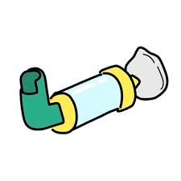
Traditional Model
Child has personal albuterol inhaler and spacer at school
Medication form(s)
Paperwork signed by doctor, parent, nurse

Slide 33
Not so simple
Up to 80% of students with asthma do not have albuterol + paperwork at school
Baltimore City anecdotal examples (asthma prevalence 20-30%):
Worst case: high school (480 students): 0 asthma forms/meds
Better case: elementary/middle school (1500 students) w a school-based health center: ~ ½ of known asthmatics had forms/meds
Alabama data (2005): 5 school systems/36 elementary schools- among children with MD-diagnosed asthma and prescribed asthma controllers:
No student had a complete asthma action plan on file
14% had albuterol physically available at school
Albuterol availability not predicted by sex, race, insurance status, asthma severity, self-reported healthcare utilization
Pediatr Allergy Immunol Pulmonol 2012

Slide 34
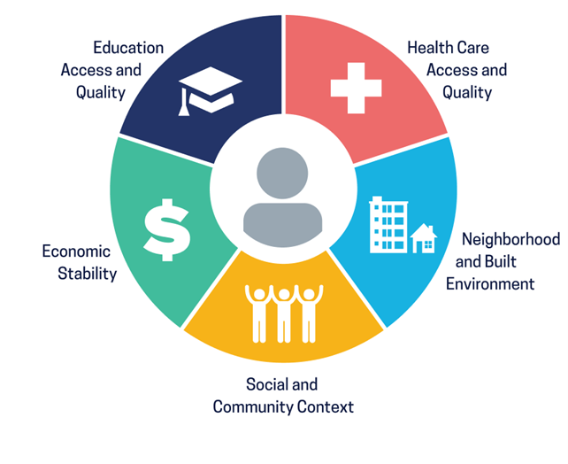
Social determinants of health and school albuterol health disparities
Literacy
Health literacy
English fluency
Asthma is properly diagnosed
PCP and/or specialist relationship exists
Insurance
Ability to navigate healthcare system
Area has sufficient PCPs/specialists
Internet access/community broadband
School can afford full-time school nurse
$ for extra inhaler and spacer
$ for school form fees
Ability to take off work
Access to transportation
Parental support
Perception/normalization of asthma

Slide 35
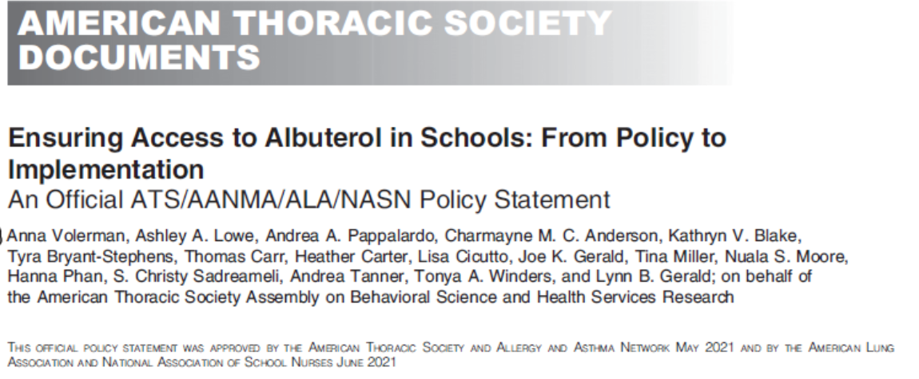
Guidelines for stock inhaler programs
Slide courtesy of Dr. Lynn Gerald

Slide 36
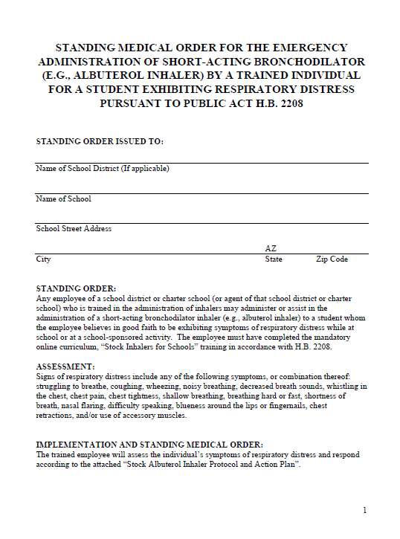
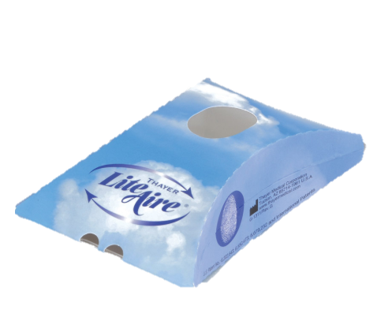
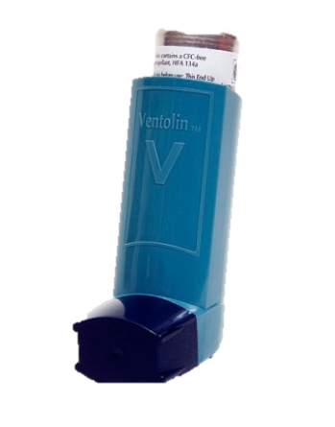
Stock inhalers for schools
Single, short acting beta agonist (SABA) inhaler (albuterol)
Supply of disposable valved holding chambers (e.g., LiteAire®)
Standing medical order and protocol
Slide courtesy of Dr. Lynn Gerald

Slide 37
How does stock albuterol legislation address health disparities?
Recognizes:
All with asthma need access to albuterol in school
Those with higher asthma morbidity/risk less likely to have it
Allows school to recognize and treat symptoms
Saves lives, fewer 911 calls
Less missed class (students) and work (parents)
Helps schools identify students who need help connecting with medical care
Costs ~$150/school/year
NOT intended to replace the “usual” way (forms, personal meds, primary care or specialist management still ideal)
Lowe J Allergy Clin Immunol 2021

Slide 38
Example protocol: Virginia
Standardized online training available- Arizona, American Lung Association

Slide 39
Maryland
5 year process
Bipartisan support
Law passed in spring 2024, went into effect 7/1/24
Requires public schools and authorizes private schools to have stock albuterol
Requires standardized training to recognize asthma, food allergy, and differentiating
Protocols being written by Maryland Department of Health
Will likely be implemented 2025-2026 school year

Slide 40
Conclusions
Asthma is diagnosed clinically
Goal is good control of symptoms and exacerbations
Be aware of age/ability differences in inhaler types
Stock albuterol legislation is one tool to help keep kids with asthma safe in schools

Slide 41
Thanks
Christy Sadreameli, MD, MHS
Asst. Professor, Johns Hopkins University
ssadrea1@jhmi.edu
Twitter: @pedlungdoc

